Slide 1
Putting you Head in the Cloud Microsoft Azure for the DBA
David Postlethwaite
Notes:
Good Afternoon.
Welcome to this presentation which is entitled “Microsoft Azure for the DBA”
so if you are expecting to hear something else you are in the wrong room.

Slide 2









GOLD SPONSORS
SILVER SPONSORS
BRONZE SPONSOR
STRATEGIC PARTNER

Slide 3


David Postlethwaite
Liverpool Victoria LV=
SQL and Oracle DBA
MCSE 2014 Data Platform
MCITP 2008, 2005
Oracle OCA
25 years IT Experience
8 years as DBA
Blog: gethynellis.com
david@clunyweb.co.uk
@postledm
https://www.linkedin.com/in/davidpostlethwaite
Notes:
Welcome
My name is David Postlethwaite, I am a SQL DBA for a large financial services company on the south coast of England
I have been working as a DBA for the last 8 years
I currently manage both SQL and Oracle instances.
Previous to that I was a developer using .NET, SQL, Access, FoxPro and Oracle
And way back in time I was a Windows and a NetWare administrator.
I am an occasional contributor to the blog on gethynellis.com

Slide 4
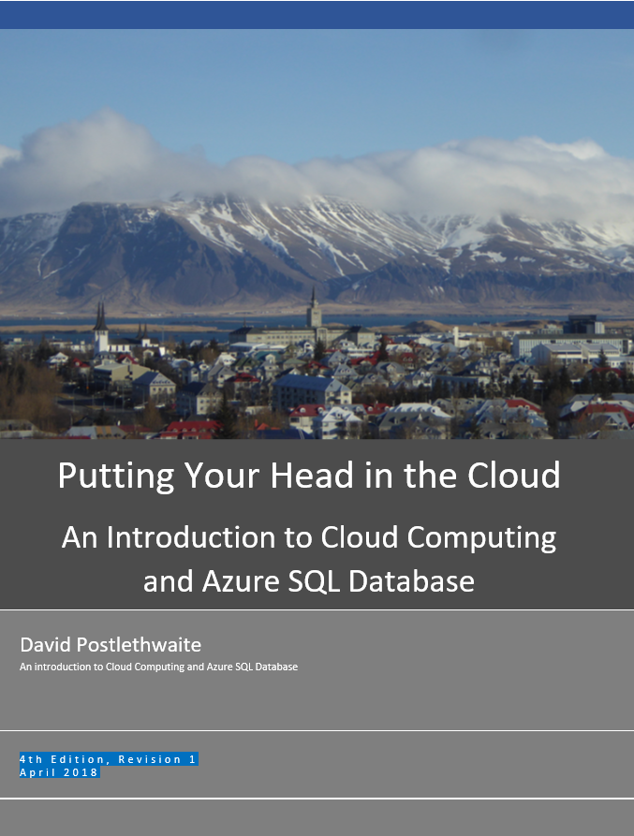
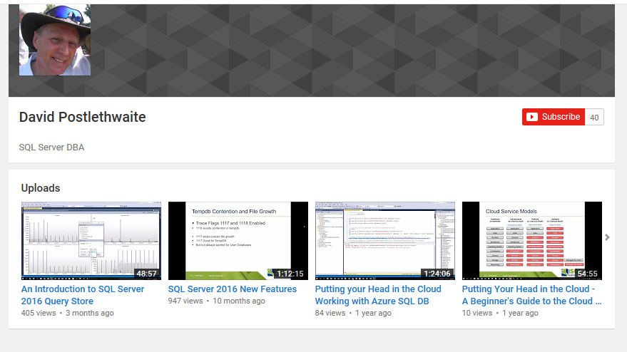
Resources
Free E-Book
Sign up at www.gethynellis.com
YouTube Channel
www.youtube.com/c/DavidPostlethwaiteSQL
Notes:
Resources
Microsoft Azure SQL Database has grown significantly since I starting speaking on Azure 3 - 4 years ago.
There just isn’t enough time to cover everything I want to in this hour
So I will have to introduce a number features but won’t have time to demonstrate them.
Instead I’ve produced short videos on my YouTube channel of the different subjects so you can watch the demos that you are interested in, in more manageable, shorter chunks
I have also produced a Free E Book
I’ve just updated it to the 4th edition for this conference
It’s over 100 pages long and covers everything that I will mention today and a lot more besides. And it has source code for all the demos
You can get this for free by signing up on www.gethynellis.com

Slide 5
Agenda
Service Models – IAAS, SAAS, PAAS
Azure – What and Where
Azure – The Portal
Azure – Creating SQL Databases
Azure – The Technical Stuff
Do you Require a DBA with Azure?
Notes:
Agenda
Before we get going, can I ask who has used Azure or the cloud before?
This talk is aimed at those who have yet to look at Azure and those who want to find out more about the options there are for Azure SQL database
We will start with a quick revision of the cloud Service Models – IAAS, SAAS, PAAS
Take a look at where Microsoft Azure is based around the world
And the services it has to offer
Then we will login to the portal, take a look at Azure and start creating databases
We’ll then get stuck into some of the technical stuff within Azure SQL database
And finally we’ll ask the question Do you require a DBA with Azure?

Slide 6
Cloud Service Models
Traditional
on-premises
Infrastructure
as a Service (IaaS)
Platform
as a Service (PaaS)
Software
as a Service (SaaS)
Hardware to Rent
Servers to Rent
Apps to Rent
Application
Application
Application
Application
Data
Data
Data
Data
Runtime
Runtime
Runtime
Runtime
Middleware
Middleware
Middleware
Middleware
Operating System
Operating System
Operating System
Operating System
Virtualisation
Virtualisation
Virtualisation
Virtualisation
Servers
Servers
Servers
Servers
Storage
Storage
Storage
Storage
Managed By Client
Networking
Networking
Networking
Networking
Managed By Vendor
Notes:
Cloud Service Models
There are three main service models in the cloud.
You will see these buzz words being used a lot in cloud discussions
These are:
IaaS Infrastructure as a Service
PaaS Platform as a Service
SaaS Software as a Service
To get a better understanding what these mean take a look at this diagram which shows the typical layers of an IT Solution
Starting from network to application
IaaS Infrastructure as a Service
Think of Infrastructure as a Service as Hardware to Rent
Instead of purchasing network equipment, storage space or servers you use the cloud provider’s infrastructure.
This means the cloud provider owns and maintains the housing, running and maintaining of all the hardware, not you.
You will need to install the operating system and database software but you don’t have to worry about maintaining the hardware.
And the cloud provider will have mechanisms in place to ensure that your hardware continues to work in the event of a failure.
Typically this would be a virtual machine, where the cloud provider supplies a server with your chosen operating system installed ready for you to install your copy of SQL server. But you will be responsible for all patching and upgrading of the software but not have to worry about the underlying hardware.
PaaS Platform as a Service
Platform as a Service can be thought of as Servers to Rent
Here the cloud provider supplies you with hardware, operating system and database server.
Typically here you will create a virtual database and then simply connect to it and start creating tables and view and procedures.
You do not have to worry about software installation, patching, upgrades, failover and backups. The Cloud provider will manage all that for you.
This is the simplest way to create a database in the cloud.
With both IaaS and PaaS you have the flexibility to use more or less storage or processing power as and when you require it. This is attractive to business which might otherwise have to maintain large amounts of storage or CPU just for occasional peak times.
Saas Software as a Service
With Software as a service we go whole way and simply rent applications over the Internet from the Vendor.
We don’t have to worry about hardware , operating systems or software maintenance.
This would be things like Office 365, Skype or PhotoShop. In fact any application where you don’t have to install it on your laptop could be considered Software as a Service.
As well as removing the need to buy, install and manage software on your computer, it also has the advantage of the software being accessible from anywhere with an internet connection.
The term “as a service” has become very popular so you will often hear vendors using it to describe their service such as “storage as a service”, “disk as a service” or “database as a service”. I’ve even seen a consultant advertising himself as “DBA as a service” where you can rent his expertise over the Internet by the hour.

Slide 7
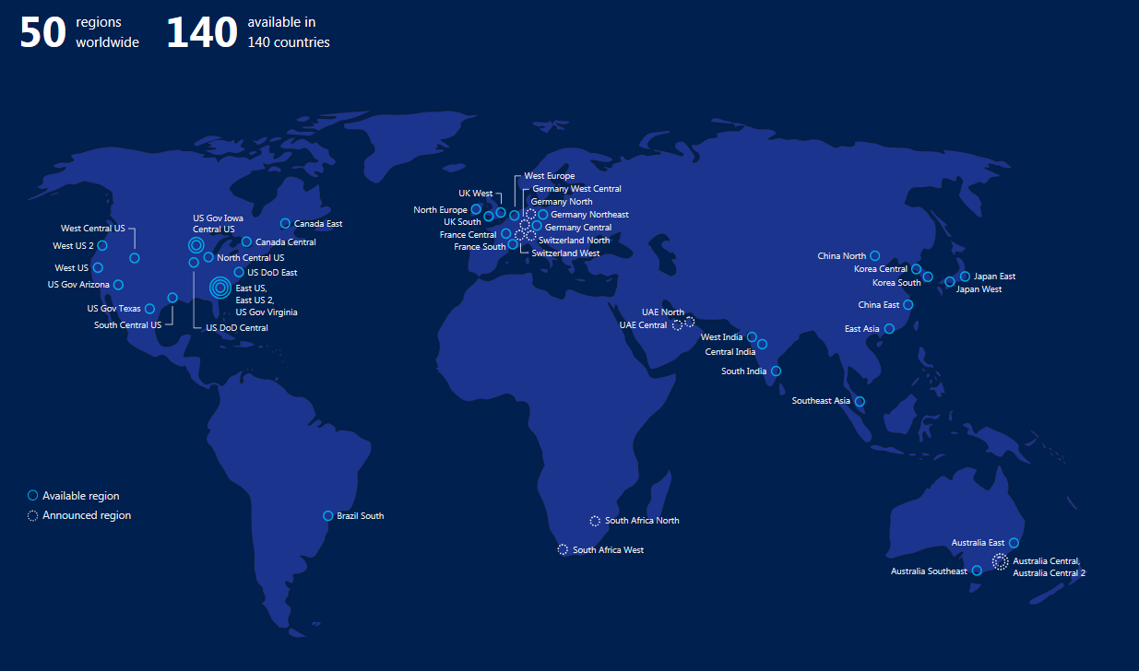
Microsoft Azure Data Centres
Notes:
Microsoft Azure
So lets take a look at the Microsoft Cloud offering
Microsoft has divided the world into regions. There are currently 50 regions with more due to come online.
Not every data centre offers every Azure service and you will see that some data centres are for US government use only
You can choose to place your cloud services in any data centre in the world (though Australia is currently limited to customers based in Australia and New Zealand)
But putting your data or applications on the other side of the world may affect your customer’s performance if they are all based in Europe.
You data held outside the US is safe from US government interference. Microsoft won a court case a couple of year’s ago where the US government wanted some emails held in the Ireland data centre but MS argued successfully that although they are on servers owned by a US company they were outside US jurisdiction.
You’ll see that there are no live data centres in Africa.
When South Africa was allowed to start using Azure a couple of years ago their nearest data centre was so far away that performance is almost unusable. There are now two data centres being built in South Africa which should help them.

Slide 8
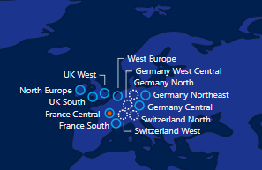
Azure European Data Centres
Notes:
Azure European Data Centres
When I started speaking on Azure there were just two data centres in Europe
North Europe in Dublin, Ireland
West Europe in Amsterdam, The Netherlands (even though Dublin is further west than Amsterdam)
There are now twelve regions in Europe.
UK South (London)
UK West (Cardiff)
Germany Northeast (Magdeburg)
Germany Central (Frankfurt)
France Central (Paris)
France South (Marseille)
Coming Soon
Switzerland North
Switzerland West
Germany West Central
Germany North
You’ll see that data centres come in pairs. Each data centre has a partner which is where the backups are sent to in case of a problem at the other data centre.

Slide 9
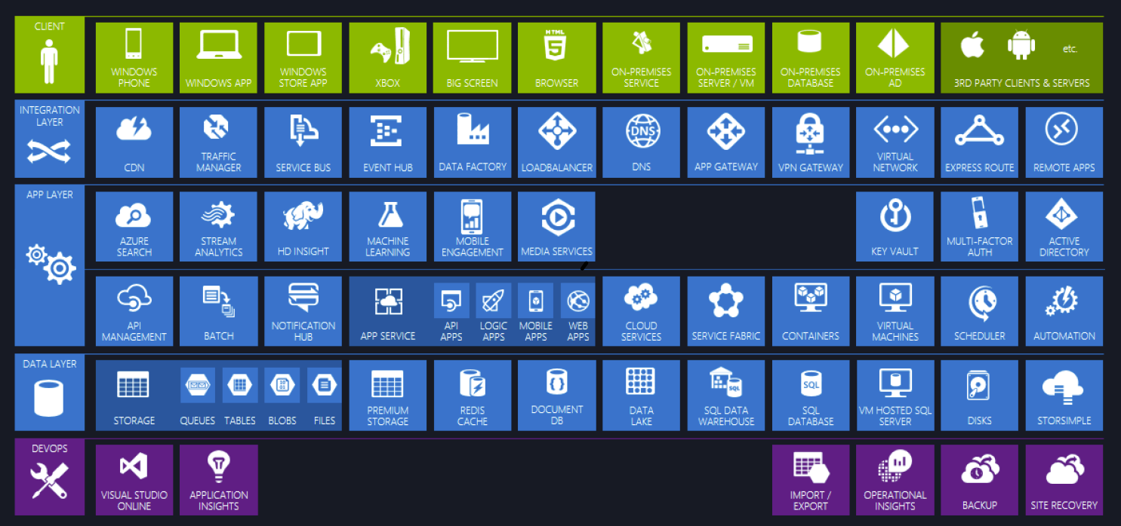
Services in Microsoft Azure
Notes:
Service in Microsoft Azure
Azure offers more than just databases and virtual servers. In fact, everything you would ever want to do in your own data centre is now available in Azure.
I seem to constantly get emails about new features in private preview.
We have SQL Database that we will be concentrating on today
Azure Data Warehouse
Azure SQL Data Warehouse, a highly scalable DBMS for data warehousing workloads built on the Massively Parallel Processing (MPP) architecture.
Azure Data Lake
Azure Data Lake allows us to store relational and non relational data of any size and shape for all types of processing and analytics.
Azure Data Factory gives us our SSIS type functionality
Azure Virtual machine. This is Infrastructure as a Service where we can build virtual machines not just with Windows but other operating systems like Linux
We can build Web sites, mobile apps and APIs with App Service
We have storage just like OneDrive and Google drive but as well as blob and file storage we also have table and queue storage
Artificial Intelligence has become becoming a very popular topic in the last year . Here we can create our Machine Learning apps.
We can join our company Active Directory to Azure to allow single sign-on and streamlined our security
We also have ways to automate and run scheduled tasks
That’s is just a few of the services available to us in Azure
12 mins

Slide 10
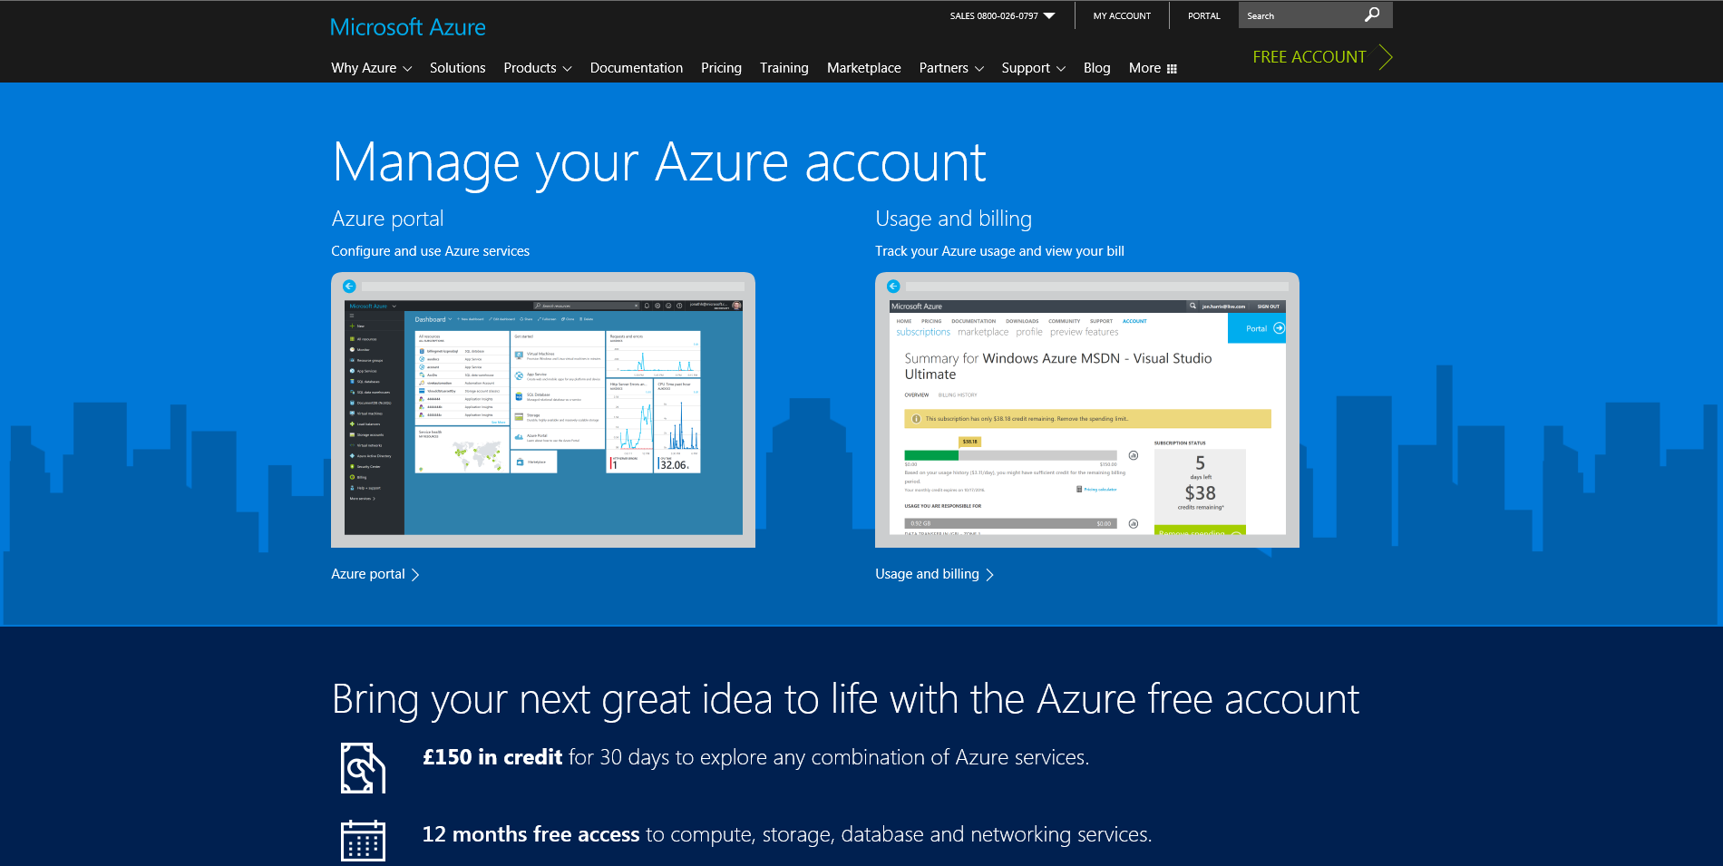
Demo Microsoft Azure
http://azure.Microsoft.com
Notes:
Demo Microsoft Azure
The URL for Azure is http://azure.microsoft.com
You can see that Microsoft are pushing hard for you to try it. There are Free Trial links in several places on the screen.
If you have an MSDN subscription then you have around €100 per month credit on Azure .
If you use all your credit your service will be disabled for that month or you can opt to pay for the extra usage.
If you don’t have an MSDN account you can create a trial account, which does require a credit card number for ID purposes, which you can try for a month.
Microsoft say they won’t take any money at the end of the trial, they will just disable your services unless you choose to start paying.
To login click on “My Account”
Then click on the “Azure Portal” image
You will require a Microsoft Live account to use Azure

Slide 11
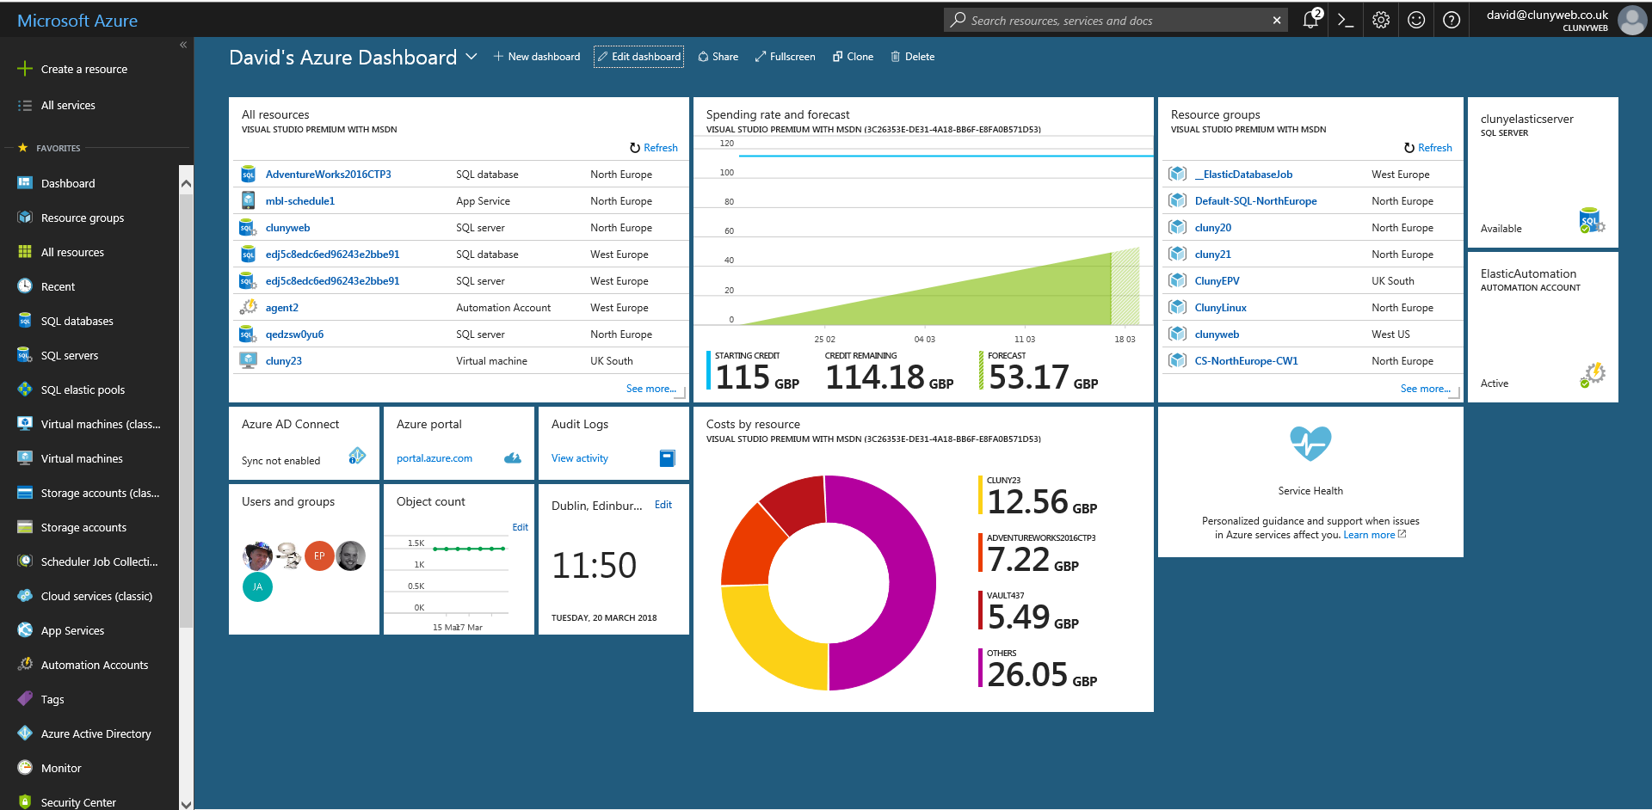
Windows Azure Portal
Notes:
Windows Azure Management Portal
The management portal is where you manage and create the different Azure services
The new portal, which went live in December 2015, uses a mixture of tiles and blades.it has improved since it first came out
Click on Browse at the bottom of the left hand side to see a list of the different services available – web site, virtual machine, SQL database, storage and many others.
Click on “All Resources” to see a list of services that have been previously created

Slide 12
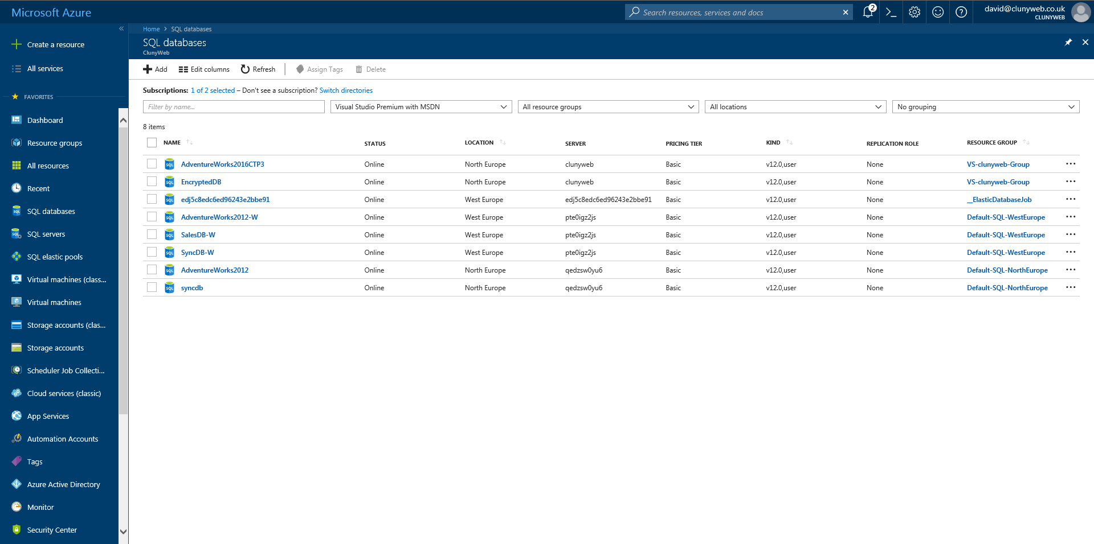
Azure SQL Database
Notes:
Azure SQL Database
We are going to concentrate on SQL databases.
Click on the SQL Databases on the left hand menu
Here we can see the list of the SQL databases that I have previously created
Azure SQL Database is an example of Platform as a Service (PaaS)
We don’t have to build a Windows server or install the SQL software or configure the SQL instance.
We don’t have to worry about software upgrades or the disk configuration.
Microsoft have done all of that for us
Azure SQL database simply provides us with a platform where we can place our data.
Once we have created a database we can connect to it from our pc using SQL Server Management Studio or connect our applications to the database by using ADO, ODBC, PHP or JDBC
With Azure SQL database all we have to do is create the tables, views and procedures that go into the database. The management of the database is all taken care of for us.

Slide 13
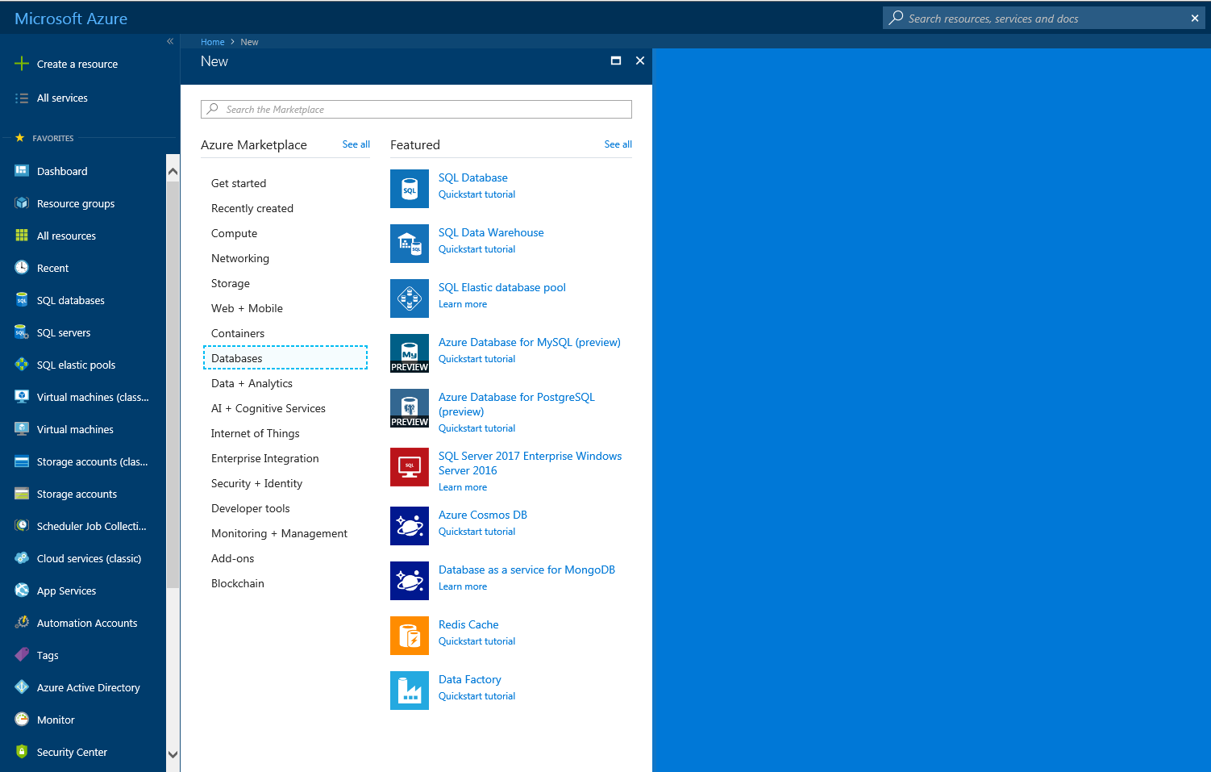
Create an Azure SQL Database
Notes:
Create an Azure SQL Database
So let’s create a SQL Azure database
There are a number of way to start the process
From the management console select +Create a Resource
Select SQL Database

Slide 14
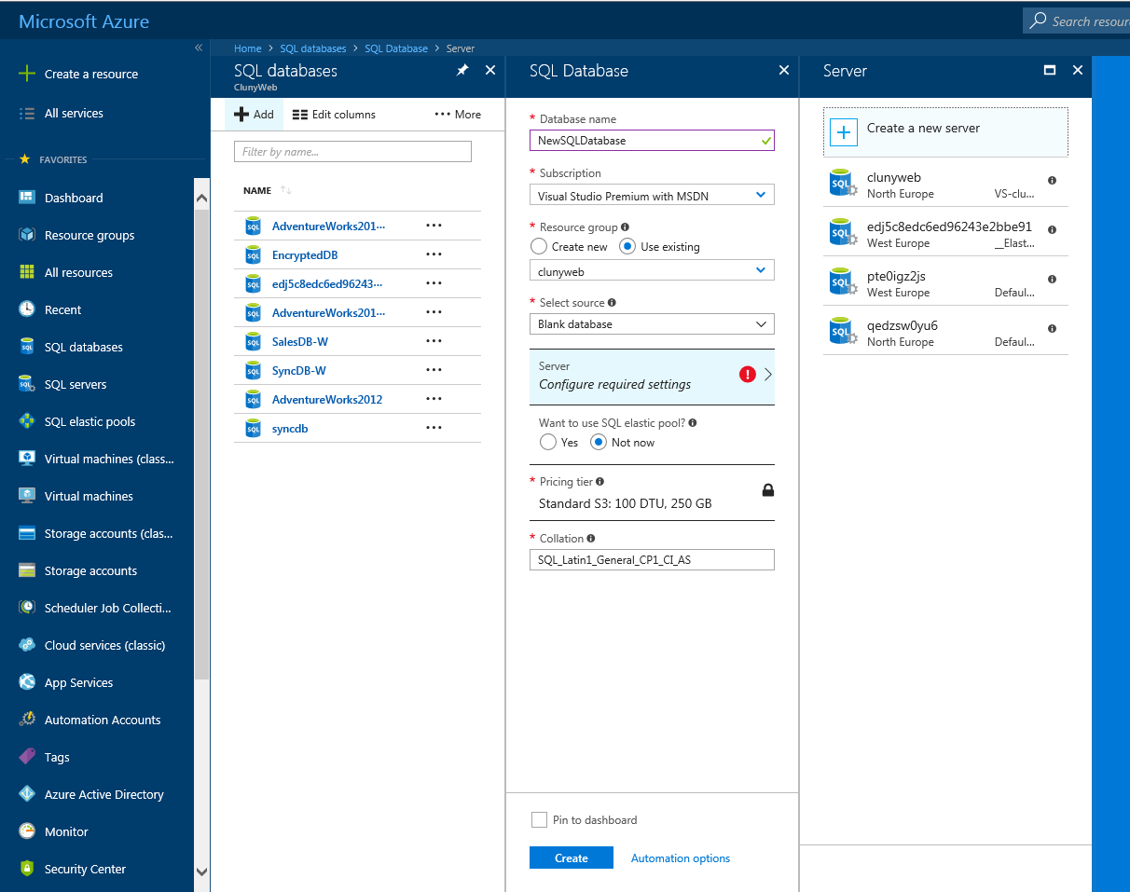
Create Azure Database
Notes:
We can now complete the information required to create an Azure SQL database
We must supply some information to create our database
A name. Azure will check that the name is valid.
A Resource Group
A resource group is a logical container for grouping related resources together. The resource group could include all of the resources for an application, or for billing purposes.
A Server in the region we want the database to reside. An Azure SQL database must be placed on an Azure SQL server. This server is simply a container to place your databases. There is very little that can be configured for a server other than its name and its location and an sysadmin password. Note. It is now possible to give an Azure SQL Server your own name, previously Azure assigned a unique random name to the SQL Server. Importantly an Azure SQL server has a maximum amount of power available to it (45000 DTUs). We will discuss Power levels and DTUs later.
A template for the database. Choose either a blank database, the AdventureWorks sample database or the latest backup of one of your existing databases. You can even choose a backup from a deleted database.
A Power level for the database. In Azure SQL database, the power of the SQL database is measured in “Database Throughput Units” or DTUs.

Slide 15
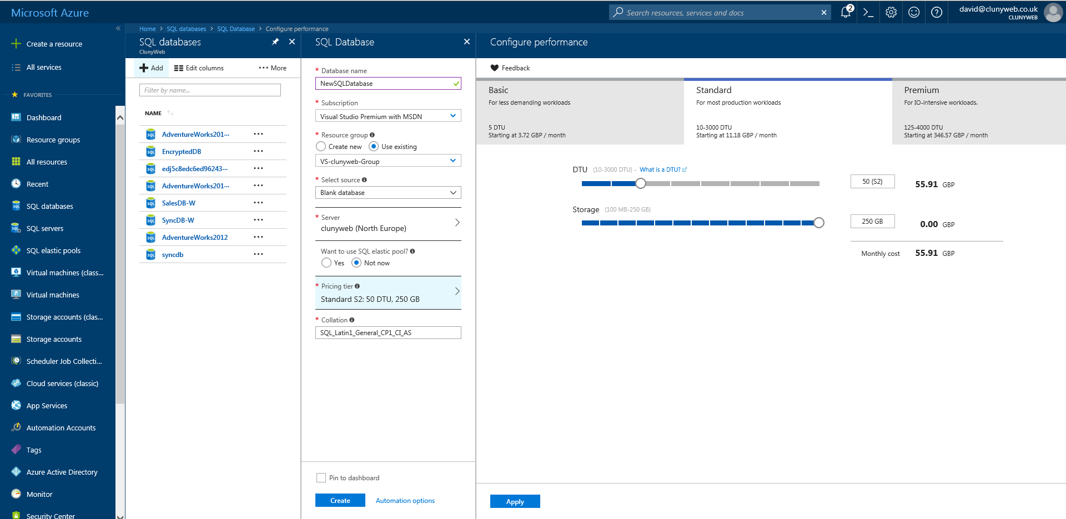
Create Azure Database - Tier
Notes:
Power level selection for a SQL Database
In Azure SQL, the power of the SQL database is measured in Database Transaction Units or DTUs.
There are three levels or tiers; Basic, Standard and Premium with several divisions in each tier.
Each offers more power than the previous and correspondingly costs more
Remember the power is set against each database NOT against the server. The server is just a container and has no attributes of its own

Slide 16
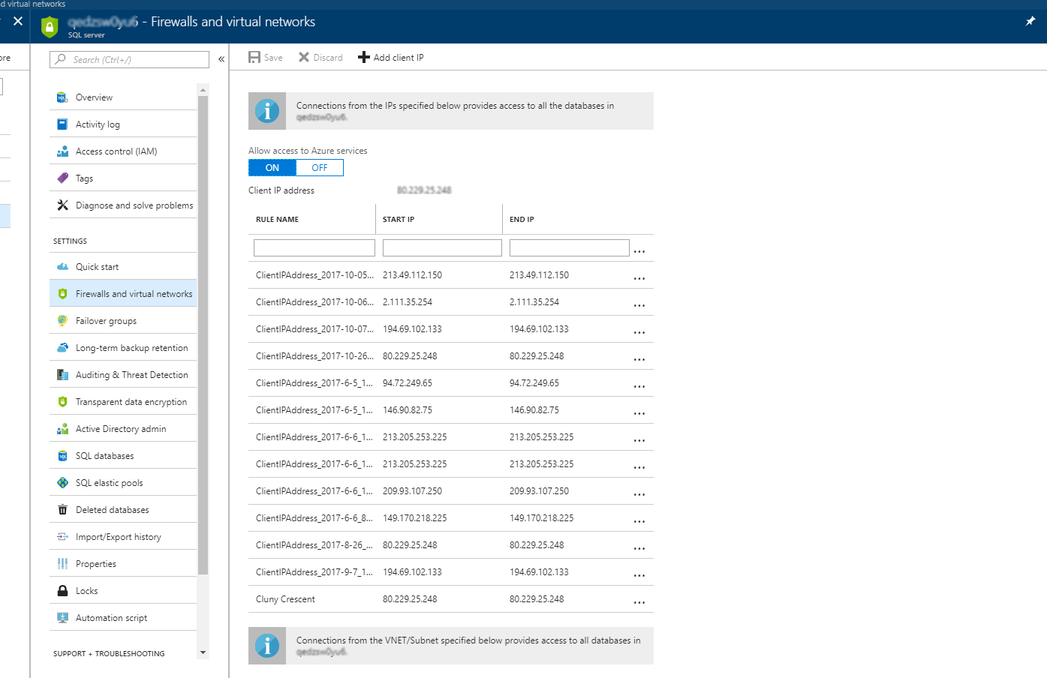
Allowing Access to Azure DB
Notes:
Connecting to a SQL Azure Database -Firewall Rules
By default, you cannot connect to a SQL database, both internally from other Azure services or externally from your office or home.
You must give access to an IP address or address range that you want to have access to the database
You can use the Server portal to setup the firewall rules necessary to allow access.
If you have setup an alert to record failed login or blocked by firewall be aware that those metrics and alerts are made against a particular database.
If you don’t specify a database in your connection string then the metric and alert won’t be picked up
Setting the Default Database
Setting the default database can affect what the databases and security that is displayed in SSMS.
If you logging in as an admin and you enter a default database in SSMS then it will only connect to that database and not give you the security information
If you leave the default database empty then you will connect to master, see all the databases on the server and also the security information

Slide 17
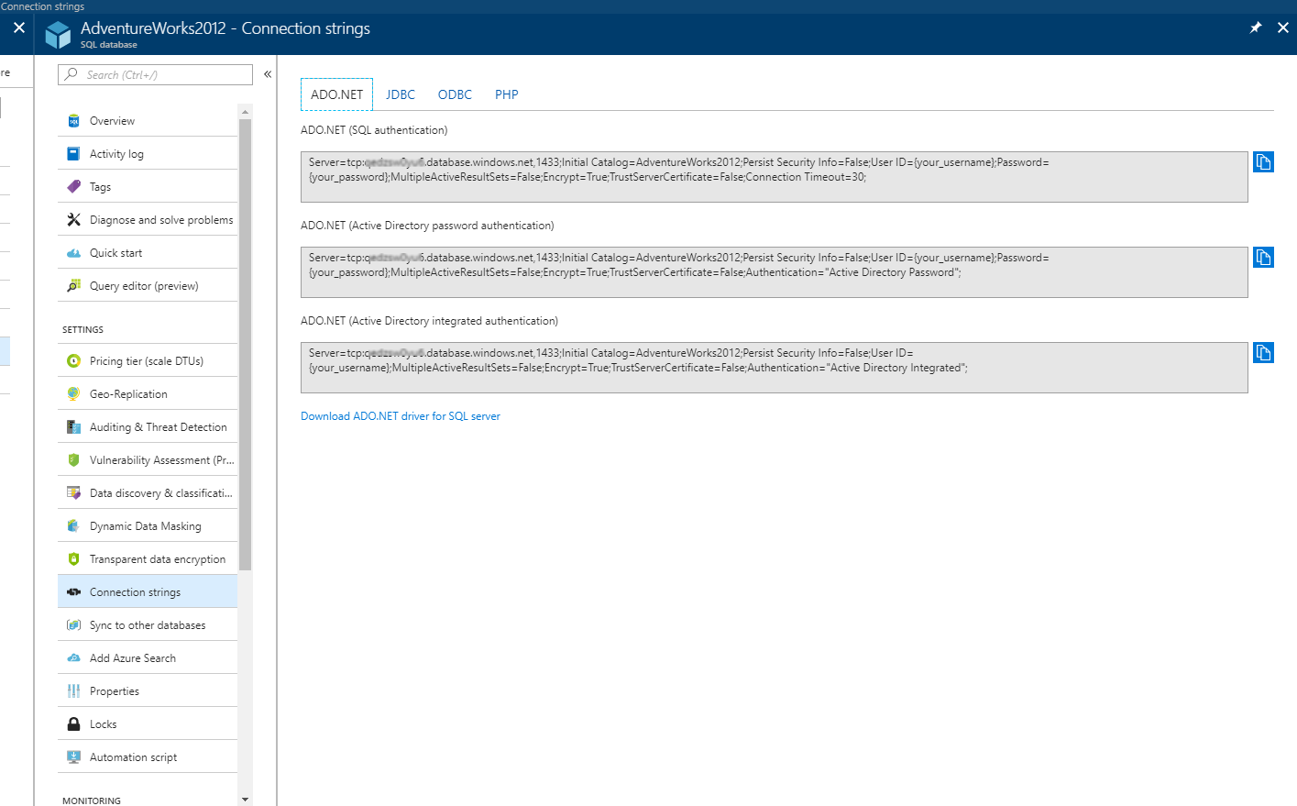
Azure Connection Strings
Notes:
Azure Connection Strings
On your premises you connect to a SQL server usually just by typing the name of the Windows server.
Azure, being on the Internet, requires a slightly more complex address.
However Azure makes it simple.
From the main database screen click on “Show Database Connection String”. Here you will see connections strings for ADO, ODBC, PHP and JDBC.
For SSMS you connect to the Azure SQL Server so you only require the first part of the ADO connection string <ServerName>.database.windows.net,1433
This can also be found on the Server screen.

Slide 18
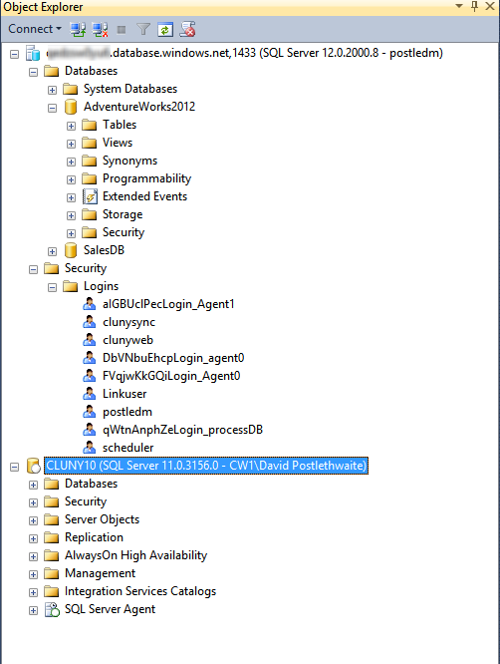
Using SSMS
Limited GUI with SSMS 2012 or SSMS 2014 RTM
SSMS 2014 SP1 and 2016/17 gives better support
Need to write code
Need the azure syntax
Can’t use “USE”
Notes:
Using SSMS
Azure SQL database is supported in SSMS 2012 and above
SSMS 2012 and 2014 RTM have limited functionality when connecting to a SQL Azure database
If you are used to using Right Click to browse and edit you are out of luck
SSMS 2014 SP1 , 2016 and 2017 will give you much more functionality for SQL Azure
Without 2014 SP1 and above if you are used to using Right Click to browse and edit you are out of luck
You will need to learn to write code again I’m afraid
We can now connect to our Azure SQL Database
In SQL Server Management Studio connect to our Azure Server using the syntax
<serverName>.database.windows.net,1433
The first thing you will notice is that there are lot less options than you get in a traditional SQL Server. The most noticeable is there is no SQL Agent
Azure SQL database is an example of database as a service. All you get is a database where you can store your data. All the extras that are in a traditional SQL server are not part of that service
If you need to run scheduled jobs then Azure offers several different service that can do that.
There is still no GUI for managing logins, even in SSMS 2017

Slide 19
Server Roles
Not the Same as local SQL Server
server-level principal account
Created with the server.
Equivalent to sa
Loginmanager
Create Logins
dbmanager
Create databases
Notes:
Server Roles
Server level roles are not the same as those found in traditional SQL Server.
In fact there are only three server level roles
Server-level Principal Account
Equivalent to sa. Can’t be called sa. The account that is created when the server is first created.
The loginmanager Role
Like the securityadmin fixed server role for an on-premises instance of SQL Server, the loginmanager database role in Microsoft Azure SQL Database is has permission to create logins.
Only the server-level principal login or members of the loginmanager database role can create new logins.
The dbmanager Role
The Microsoft Azure SQL Database dbmanager database role is similar to the dbcreator fixed server role for an on-premises instance of SQL Server.
Only the server-level principal login or members of the dbmanager database role can create databases.

Slide 20
Logins and Users
SQL Logins
Default option
USE Master
CREATE LOGIN login1 WITH password=‘Password123';
USE DB1
CREATE USER login1User FROM LOGIN login1;
EXEC sp_addrolemember 'dbmanager', 'login1User';
EXEC sp_addrolemember 'loginmanager', 'login1User’;
Contained Users
Recommended option
USE DB1
Create user CUser1 with password = 'Password123'
ALTER AUTHORIZATION ON SCHEMA::[db_owner] TO [CUser1]
ALTER ROLE [db_owner] ADD MEMBER [CUser1]
Notes:
SQL Logins
Originally Azure SQL database only support SQL logins. These work in exactly the same way as SQL logins in a traditional SQL server
Contained Users
Azure SQL database is actually a contained database
Contained databases were introduced in SQL Server 2012 and allows a SQL database to be independent from the SQL Server
With a contained database you no longer need a server level login, you can create a user at the database level with its own password
Microsoft recommend using contained users to avoid having to interact with the master database (which could be on a different physical server) during login
However this can then use just database firewall rules rather than server firewall rules

Slide 21
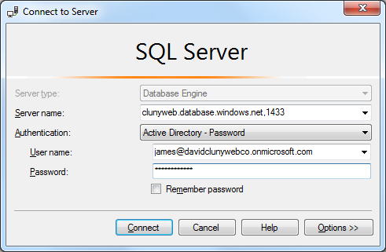
Azure Active Directory
Azure SQL Database supports Azure Active Directory Users
create an Active Directory admin for your Azure SQL Server
Then create AD logins in the database
Create user [james@clunywebco.onmicrosoft.com] from external provider
SSMS supports Active Directory with Password
Notes:
Azure Active Directory
We can use Azure Active Directory Logins to login to an Azure SQL database.
You can connect your own active directory domain to Azure but Azure will assign you a system defined Active Directory as well
You can create Active Directory logins in the portal and assign one as the active directory admin to the Azure SQL server
You can then login to the Azure database using the active directory admin and add the other active directory users to the database
But you must be logged in as an Azure AD login first
Create user [james@davidclunywebco.onmicrosoft.com] from external provider

Slide 22
Limitations of Azure SQL Database
Always On Availability Groups
Attach a database
BACKUP and RESTORE statements
Change data capture
Common language runtime (CLR)
Database mail
Database mirroring
Data Quality Services (DQS)
Database snapshots
Extended stored procedures
Filestream
Linked servers
https://msdn.microsoft.com/library/azure/ee336281.aspx
Log shipping
Master Data Services (MDS)
Minimal logging in bulk import
Modifying system data
Policy-based management
Anything to do with Agent and msdb
Features related to database file placement, size etc.
Many DBCC commands
Global temporary tables
SHUTDOWN
Notes:
Limitations
Azure SQL database doesn’t support every feature that you find in traditional SQL Server and you should be aware of this when you are designing a database for Azure.
Version 12 of Azure SQL DB provides much closer compatibility to SQL 2017 than the previous v11. So watch out for old documentation
Most SQL Server T-SQL statements are fully supported such as most data types, operators, string, arithmetic, logical, cursor functions, and the other T-SQL elements that most applications depend upon.
Partially or unsupported functions are usually around server level activities such as files, high availability, and security features or for special purpose features such as service broker.
The list is changing so check the website for the latest update

Slide 23
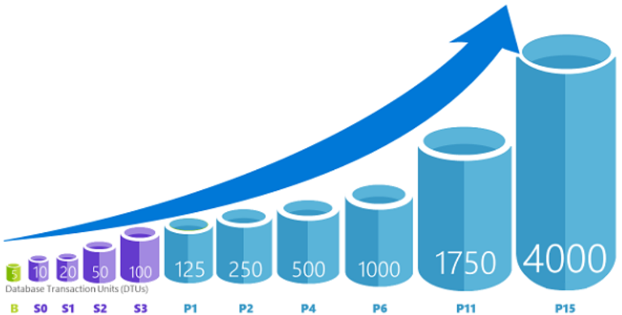
Azure Database Service Tiers
Basic is best suited for a small size database, supporting typically one single active operation at a given time such as for development or testing, or small scale infrequently used applications.
Standard is the best option for most cloud applications, supporting multiple concurrent queries such as workgroup or web applications.
Premium is designed for high transactional volume, supporting a large number of concurrent users and requiring the highest level of business continuity such as mission critical applications
Notes:
Azure Database Service Tiers
https://azure.microsoft.com/en-gb/documentation/articles/sql-database-service-tiers/
There are three performance levels for Azure SQL database - Basic, Standard and Premium
Each Service tier has several different Power levels which are measured in Database Transaction Units or DTUs (these used to be called Database Throughput Units)
A DTU represents the power of the database engine as a mix of CPU, memory and read and write rates.
Unlike your traditional SQL server you cannot choose the number of CPUs, memory or disk configuration.
The reason for this different power rating is, I suspect, to avoid people trying to do a direct comparison of their onsite server performance with that on Azure.
Basic is best suited for a small size database, supporting typically one single active operation at a given time such as for development or testing, or small scale infrequently used applications.
Standard is the best option for most cloud applications, supporting multiple concurrent queries such as workgroup or web applications.
Premium is designed for high transactional volume, supporting a large number of concurrent users and requiring the highest level of business continuity such as mission critical applications.

Slide 24
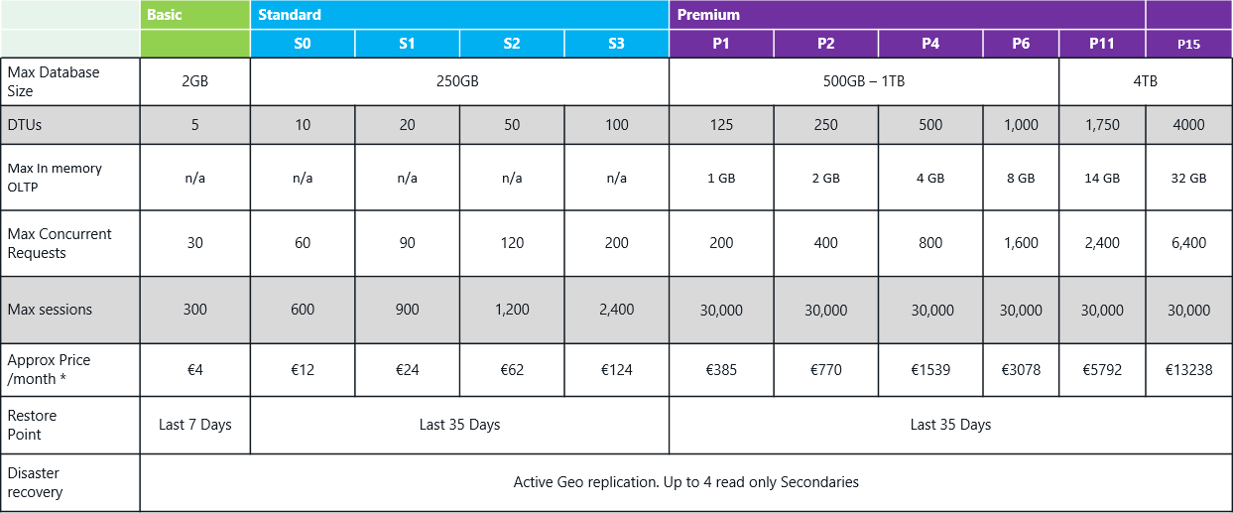
Service Tiers and Performance Levels
* Prices as at April 2018
Notes:
Performance Levels
Here is a table of what each tier offers
This is changing and improving all the time
Each service tier has a maximum database size from 2GB for Basic up to 4TB for Premium.
The DTU number allows you to see the relative power of the different performance levels.
Basic has 5 DTU. So you can expect S1, which is 20 DTU to give you 4 times the power of Basic.
P1 is 12.5 times more powerful than S0.
You decide on the power level you think you require and then monitor and tune the database as required.
It is very easy to change from one tier to another if you decide you need more or less power.
Remember you set the power level of the database, not of the underlying server.
Max concurrent requests is the maximum number of concurrent user/application requests executing at the same time in the database.
Max sessions is the maximum number of concurrent open connections to the database

Slide 25
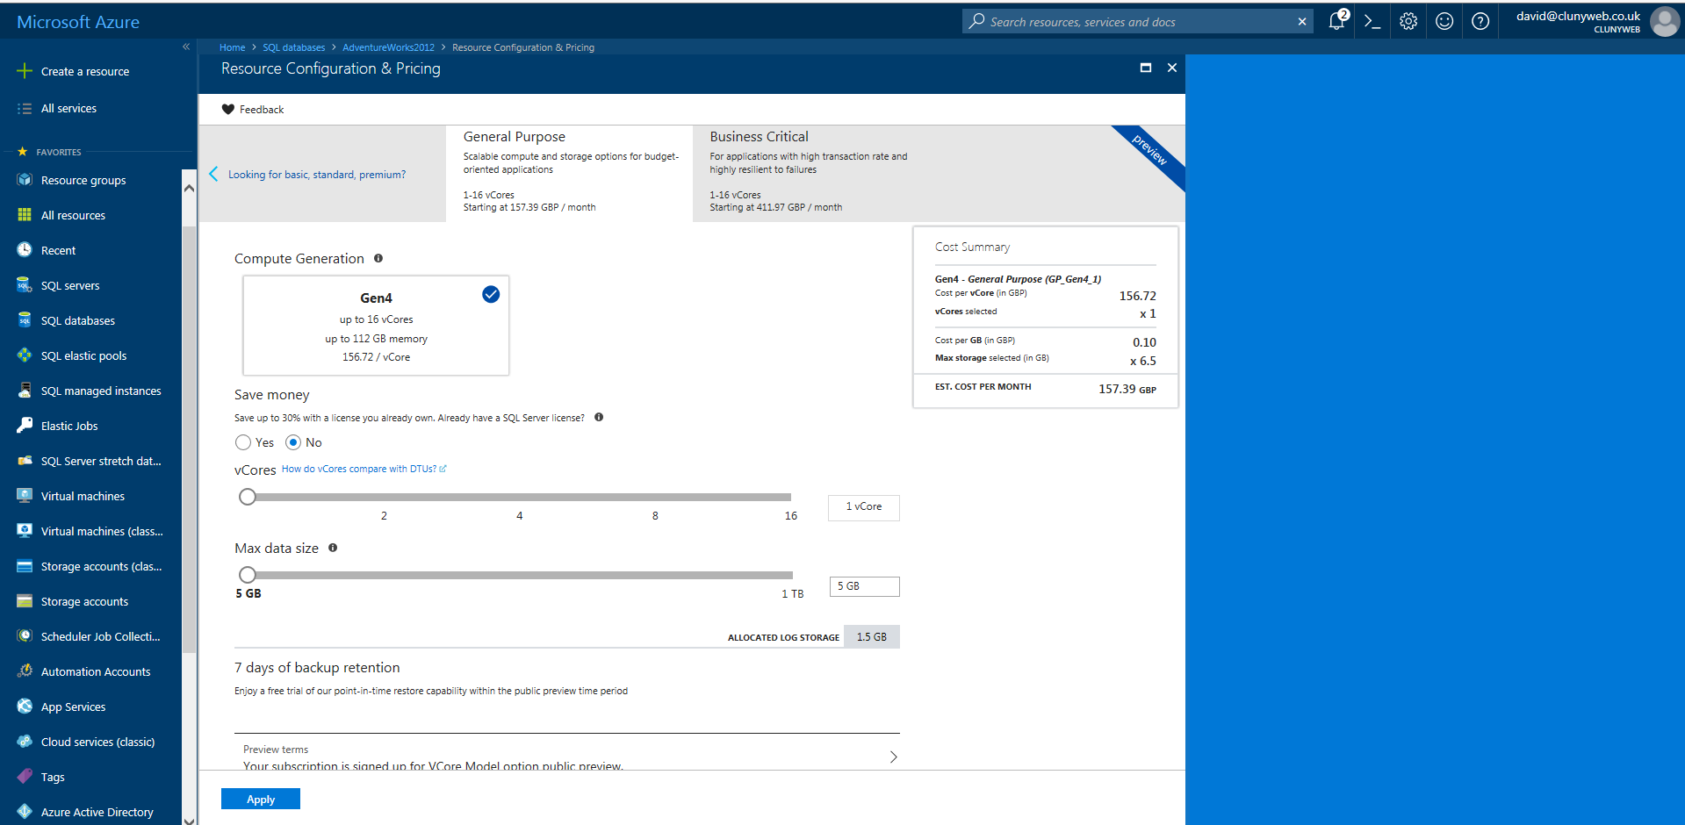
New vCore Service Tiers
https://docs.microsoft.com/en-us/azure/sql-database/sql-database-vcore-resource-limits
Notes:
vCore Pricing Tier
But things are changing
In the last month Microsoft have released two new service tiers that allow you to choose the number CPUs and memory instead of using DTUs
These are called vCore General and vCore Business Critical.
You can choose between 1 and 16 vcores which will give you between 7GB - 112GB memory
These are in preview are not cheap (minimum £150 per month) and you will see that is mention of SQL Server licences which the DTU model doesn’t do
If you have a SQL server licence with Software Assurance then the prices are reduced
Find out more at
https://docs.microsoft.com/en-us/azure/sql-database/sql-database-vcore-resource-limits
Since this is still in preview and I haven’t had an opportunity to review the vcore model the information in this talk will be for the DTU model

Slide 26
Backups and High Availability
Full database backup once a week,
Differential database backup once a day,
Transaction log backup every 5-10 minutes.
Full and differential backups are copied to the partner region
Retention: Basic 7 Days, Standard 35 Days, Premium 35 Days
Long Term Backup option available for up to 10 years
HA
Three database replicas on different physical hardware one primary replica two secondary replicas.
GEO Replication
Up to Four read only secondaries in different data centres
Ability to failover on demand
Notes:
SQL Database backups
With Azure SQL database, managing backups and High Availability such as mirroring and replication is all taken care for you
Backups
Backups are automatically created for every active database:
Full database backup once a week,
Differential database backups are created at least once a day,
Transaction log backups every 5 -10 minutes depending on activity.
The full and differential backups are copied to the partner region to ensure availability of the backups in the event of a disaster in the primary data centre.
High Availability
Additionally it maintains multiple copies of the database in different physical locations in the primary data centre to mitigate outages due to hardware failures.
At any one time, there are three database replicas running one primary replica and two secondary replicas.
Data is written to the primary and one secondary synchronously and to the second replica asynchronously.
If the hardware fails on the primary replica, the database fails over to the secondary replica seamlessly .
In case of a physical loss of a replica, a new replica is automatically created.
So there are always at a minimum two physical, transactionally consistent copies of your data in the data centre.
And you don’t have to do anything to manage that. Its all done for you.
Geo-replication
You can also setup your own replication to another data centre
Here you can have asynchronous replicas of the primary database in another region. (Azure will recommend the partner region but you can chose anyone you like)
You can have up to 4 read-only secondaries in any Azure region.
BUT You will pay extra for the these extra databases.
You can break the replication or manually failover at any time and the replica will become an online database
So you can see that log shipping, mirroring and Always On type functions can be added with little effort.

Slide 27
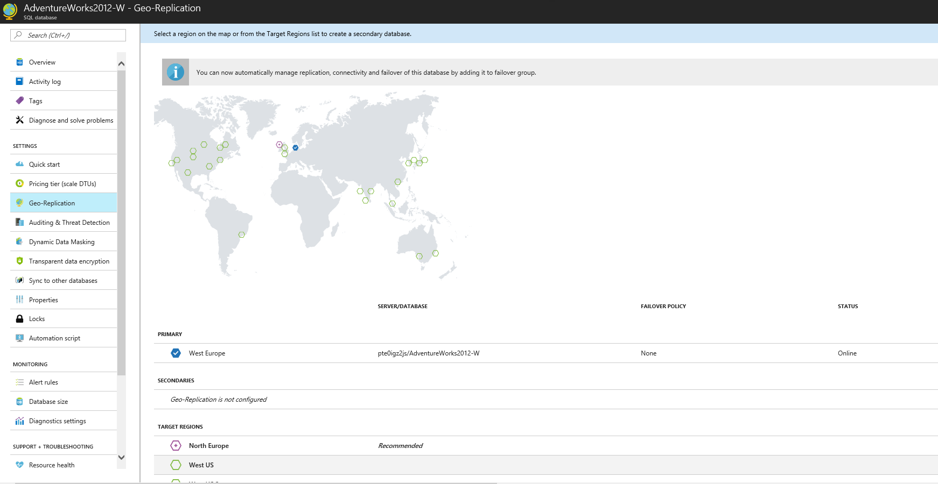
Geo-Replication
Notes:
Geo-Replication
Active Geo replication is now available for all databases tiers
This offers read only secondary in another data centre with failover capability
Ability to create the secondary database in any region in the world
Ability to connect to the secondary database with read-only access
Ability to create up to 4 parallel secondary databases in the same or different region
Ability to configure performance objective of the secondary database
When failover is activated to one of the secondary databases, other secondaries are automatically linked to the new primary

Slide 28
SQL Database Restore
 | Basic | Standard | Premium
Point In Time Restore | Any restore point within the past 7 days | Any restore point within the past 35 days | Any restore point within the past 35 days
Geo-Restore | ERT* < 12 hours RPO† < 1 hour | ERT* < 12 hours RPO†< 1 hour | ERT* < 12 hours RPO† < 1 hour
Active Geo-Replication | ERT* < 30 seconds RPO† < 5 seconds | ERT* < 30 seconds RPO† < 5 seconds | ERT* < 30 seconds RPO† < 5 seconds
* Estimated Recovery Time (ERT) - The estimated duration for the database to be fully functional after a restore/failover request.
† Recovery Point Objective (RPO) - The amount of most recent data changes (time interval) the application could lose after recovery.
Notes:
Restore a Database
In the event you need to restore a database it can be done from the Management Portal
Point-in-time restore
Basic, standard, and premium all offer point in time restore.
But you cannot overwrite an existing database
You can ONLY restore to a new database on the same server.
Be warned backups are only kept for a certain period depending on your service level.
Basic kept for the last 7 days
Standard 35 days
Premium 35 days
Also note that you cannot access these backups to download and store elsewhere.
If you need to keep backups for longer periods then you will have to create an automation task to do that for you
There is a new service, currently in preview, that will allow you to keep backups for up to 10 years. This can be found on the server screen.
Geo-restore
In the event of a catastrophic failure of the primary data centre Geo-restore allows you to restore a database to your partner region
This option only becomes available in the portal when the primary database has gone offline
Geo Replication
Geo Replication offers much better times in the event of the primary going offline
(The ERT and RPO values are engineering goals and provide guidance only. They are not part of SLA for SQL Database)
15 mins

Slide 29
Security and Monitoring in Azure
Notes:
Security and Monitoring in Azure
One of the major concerns over using the cloud to hold your data is security. You are in effect putting your data on a server that is being shared with possibly hundreds of other people
Microsoft have obviously put in place mechanisms and procedures to ensure your data systems stay isolated from anyone else in Azure
But what options do we have to keep our data secure from potential attack?

Slide 30
SQL Azure Firewall Security
IP Security
Server level
EXEC sp_set_firewall_rule
@name = N’SFirewallRule1',
@start_ip_address = '192.168.100.30’,
@end_ip_address = '192.168.100.30’
EXEC sp_delete_firewall_rule @name = N'SFirewallRule1'
Database Level
EXEC sp_set_database_firewall_rule
@name = N'DBFirewallRule1',
@start_ip_address = '192.168.1.50’,
@end_ip_address = '192.168.1.50’
SELECT * from sys.firewall_rules;
Notes:
SQL Azure Security
By default, you cannot connect to a SQL database. You must give access to an IP address or address range that you want to have access to the database
We have already done this on the Dashboard Page – “Manage Allowed IP Addresses”
We can also do this using T-SQL
The firewall rules can be either at a server level or database level
You can set server level firewall rules (but not database rules) with the Portal
You can use T-SQL to set database and server level firewall rules (use master database for server level)
--Firewall Rules
--Server level
--here or in the GUI
-- USE MASTER
SELECT * from sys.firewall_rules;
--create server level firewall rule
EXEC sp_set_firewall_rule
@name = N'SFirewallRule1',
@start_ip_address = '192.168.1.11',
@end_ip_address = '192.168.1.11'
--delete server level firewall
EXEC sp_delete_firewall_rule @name = N'SFirewallRule1'
--Database level
--only possible from here
--USE AdventureWorks2012
Select * from sys.database_firewall_rules;
GO
--create database level firewall
EXEC sp_set_database_firewall_rule
@name = N'DBFirewallRule1',
@start_ip_address = '192.168.1.50',
@end_ip_address = '192.168.1.50'
--delete database level firewall
EXEC sp_delete_database_firewall_rule @name = N'DBFirewallRule1'
You must also explicitly allow other Azure services to connect to your database on the same “Manage Allowed IP Addresses” screen

Slide 31

SQL Azure Security
Internet
Server Level Firewall Rules
Yes
Access from Azure
No
Client IP address in
Server Level Firewall Rules
No
Database Level Firewall Rules
Yes
Client IP address in
Database Level Firewall Rules
No
Access to any database
Yes
Login Name and Password
Access to specific database
Login Name and Password
Notes:
SQL Azure Security
Here is an explanation of Azure Security
First the Server level rules are checked
If the server rules pass then you can connect to any database on that server
If the server rules fail the database rules will be checked
If the database rule is passed then you can only connect to that one database
You must explicitly allow other Azure services to connect

Slide 32
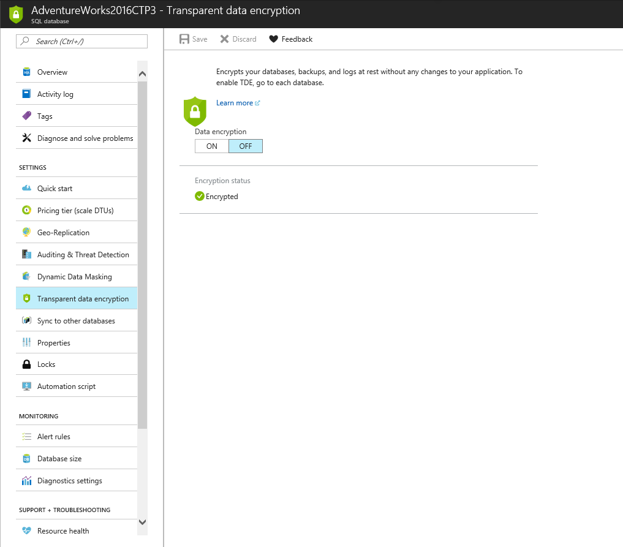
Transparent Data Encryption (TDE)
Notes:
Transparent Data Encryption (TDE)
All new databases will have TDE enabled by default
Old databases can be updated to include TDE
Azure manages the certificates. You do not have access to them
New option just announced you can now use your own certificates
This ensure your database is secure in the event that the data files are stolen
Backups (BACPAC files) are not encrypted

Slide 33
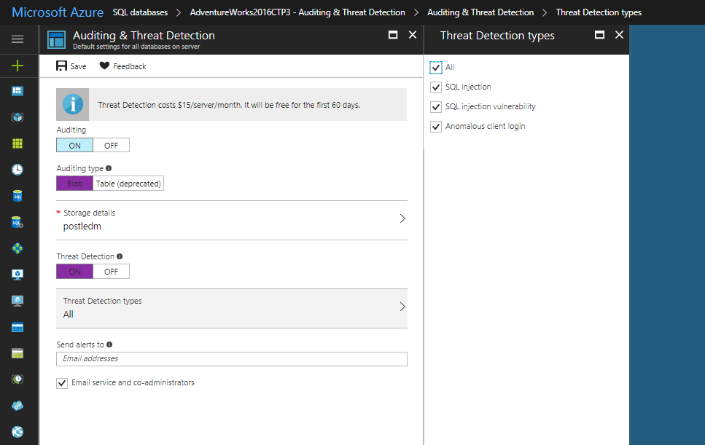
Auditing & Threat Detection

Slide 34
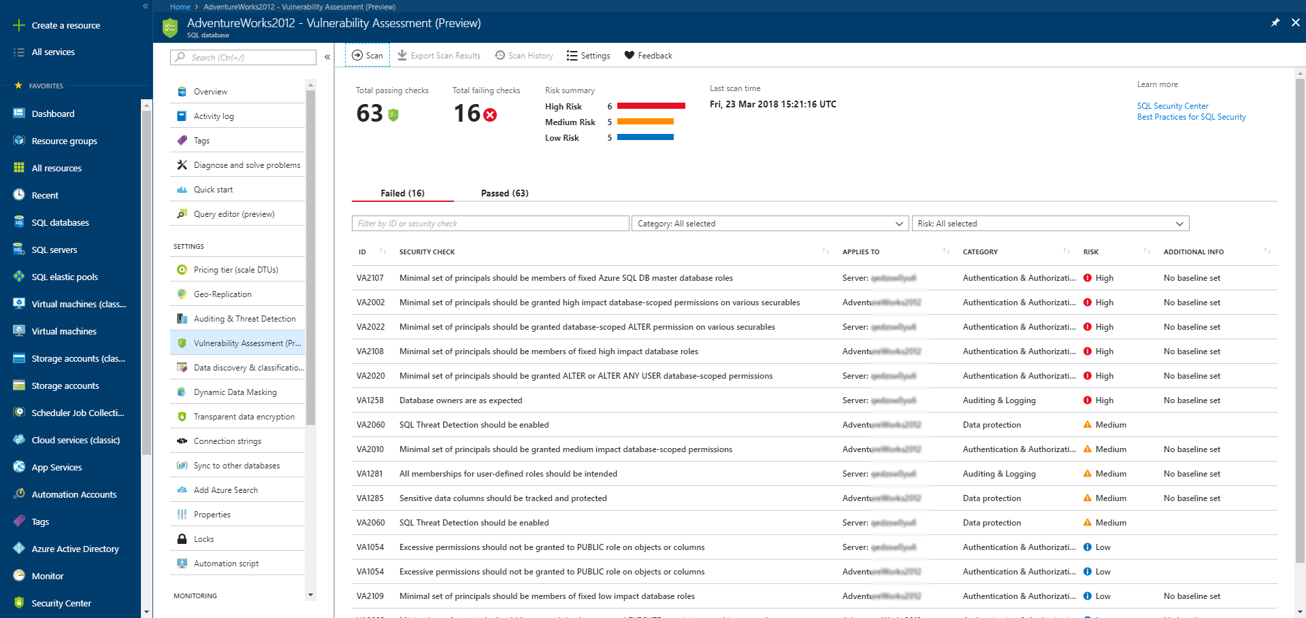
Vulnerability Assessment (preview)

Slide 35
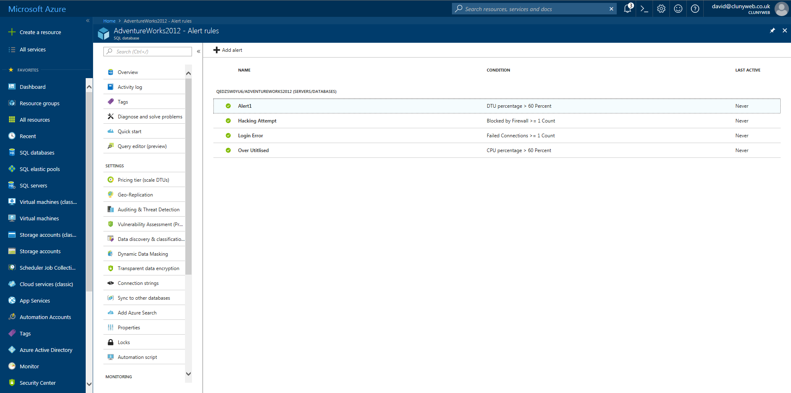
Alert Rules

Slide 36
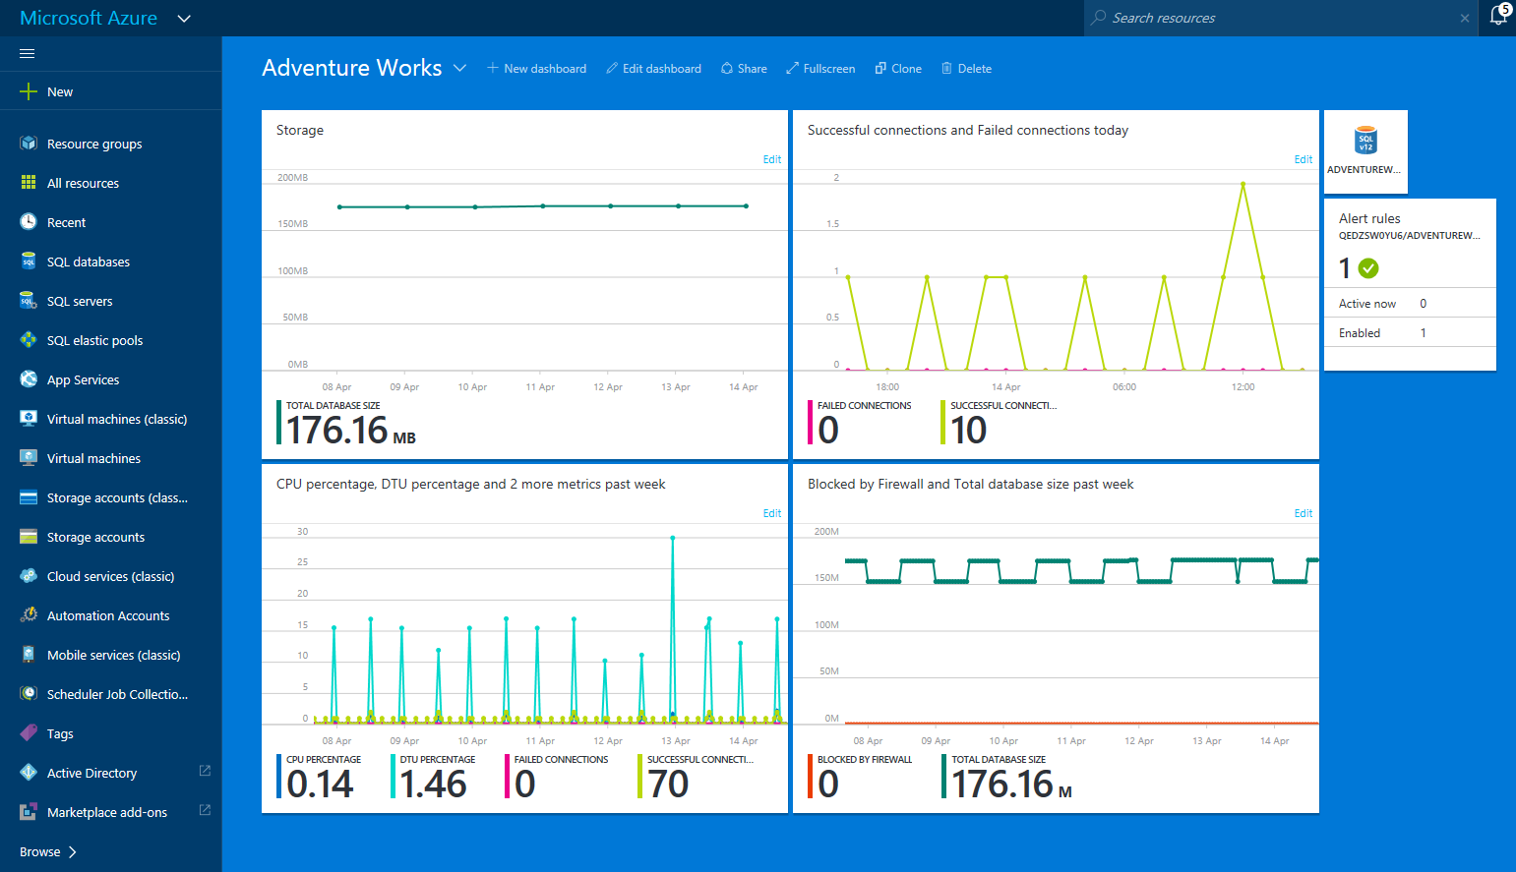
SQL Database Monitor
Notes:
SQL Database Monitor
The default screen for a SQL database has a small image in the middle for monitoring metrics on the database.
One nice feature of the new portal is to create your own dashboard so its possible to create a dashboard with your own graphs
At the top of the portal click New Dashboard.
Edit the title
On the left side select
Tiles by Type
Type of SQL Databases
Resource AdventureWorks2012
Drag the “database size” onto the screen
Resize using the “…” link
Click edit to change the metric and time range
We can also add alerts to warn us when these metrics go over a certain threshold
Drag the Database Alerts tile onto the screen
We’ll set up alerts on “Blocked by Firewall” and “Failed Connection”
Here’s a thought.
Metrics and alerts are made against a particular database. The blocked by firewall is most likely stopped at server level not database level.
So how can it be recorded against a database when it can’t possibly get there?
Well if you don’t specify a database in your connection string then the metric won’t be picked up

Slide 37
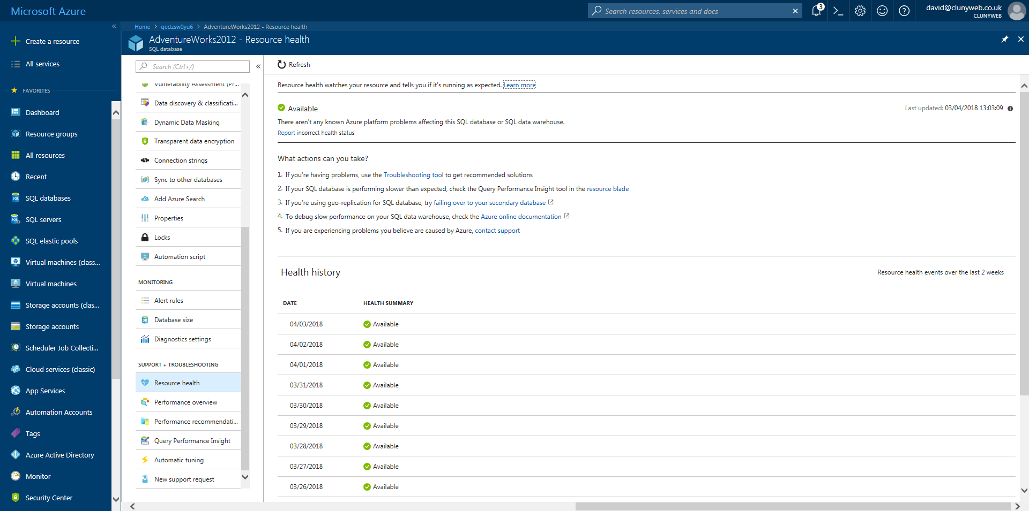
Resource Health

Slide 38
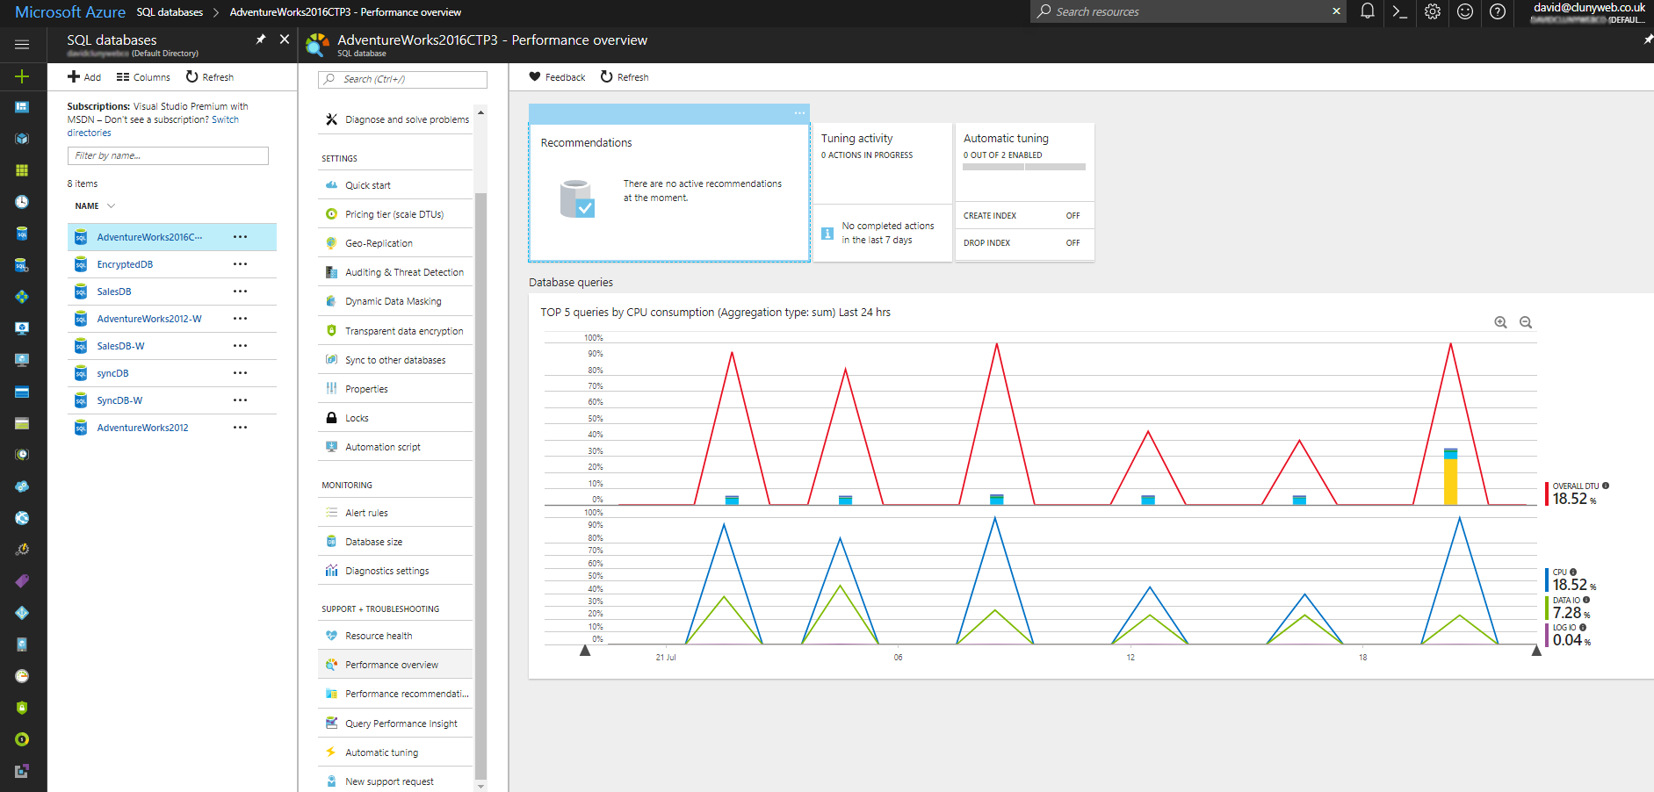
Performance Overview

Slide 39
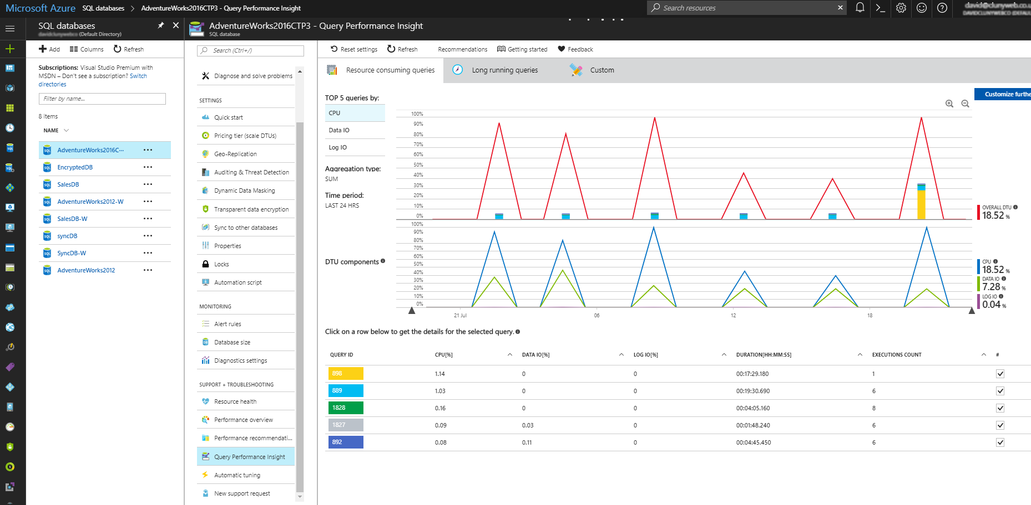
Query Performance Insight

Slide 40
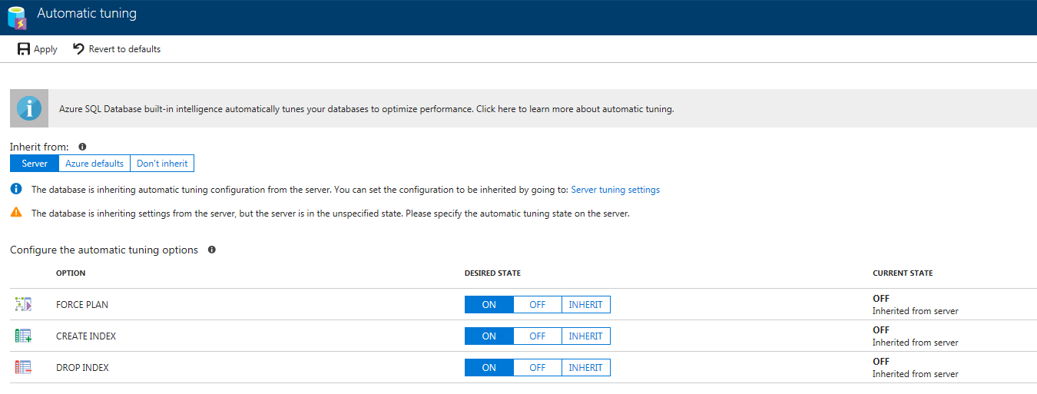
Automatic Tuning

Slide 41
SQL Agent
No Agent in Azure SQL Database
Notes:
SQL Agent in Azure SQL DB
You will remember that with Azure SQL Database there is no SQL Agent
so you can’t create scheduled agent jobs within a SQL Azure database.
Remember SQL Azure Database is an example of a database as a service so only offers a the features of a database. i.e. somewhere to place your tables and data
What options do we have to run scheduled tasks against an Azure SQL database?

Slide 42
Linked Servers
Need to create ODBC DSN
System Server Native Client 11
Linked Server
Microsoft OLE DB Provider for ODBC Drivers
Azure stored procedure you must enable RPC
Notes:
Linked Servers
It is possible to create a linked server from On Premises SQL Server to an Azure SQL Database however it does a take a couple of extra steps
You must create an ODBC DSN that connects to your Azure SQL server
Then create a Linked server to that ODBC
It would then be possible to run Agent jobs on your local SQL Server that ran queries and procedures on your Azure SQL database.

Slide 43
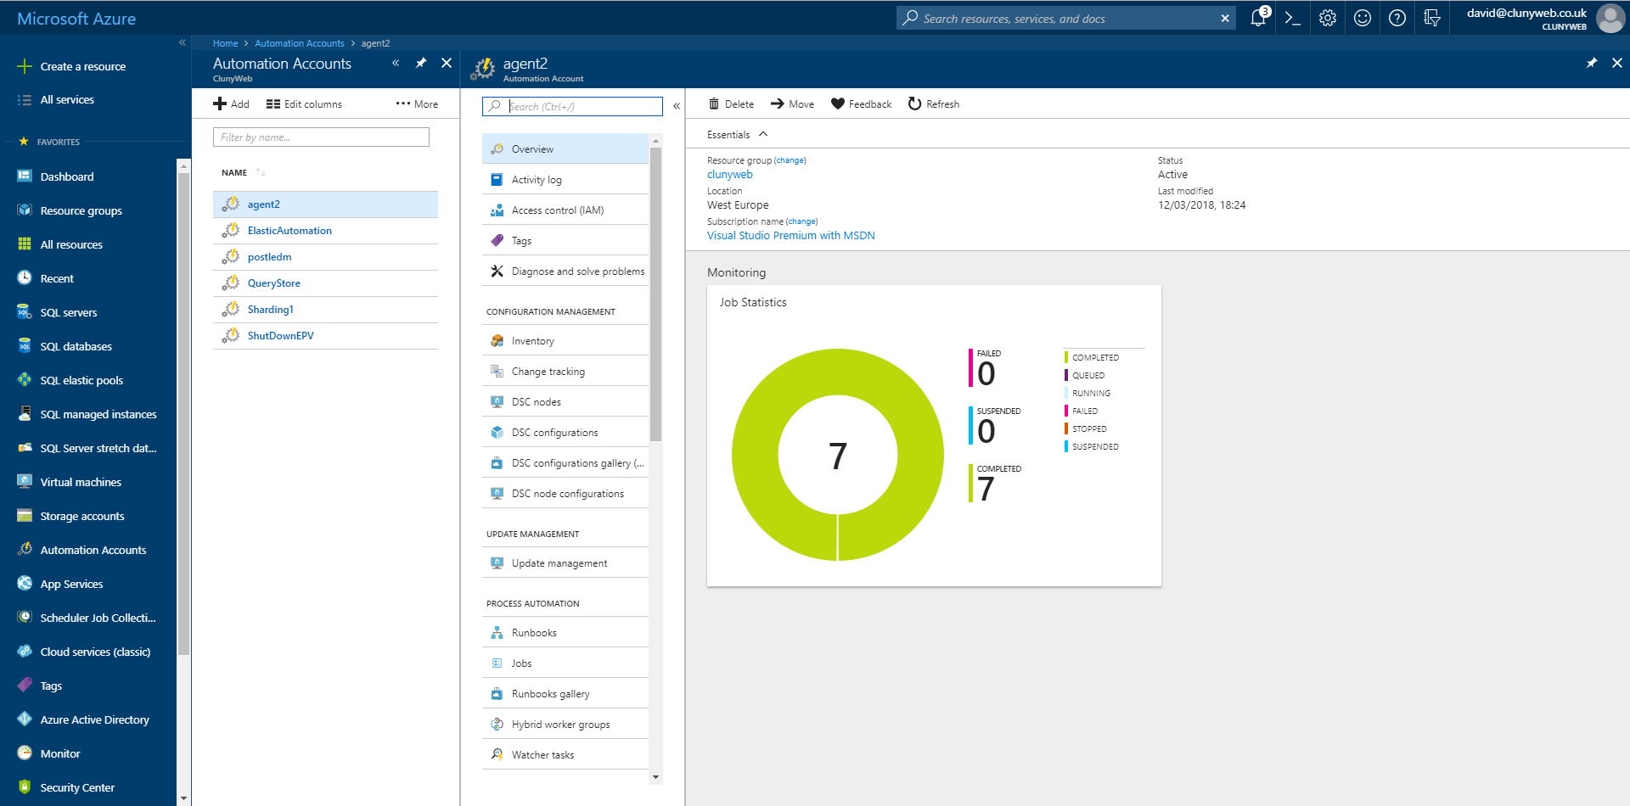
Azure Automation
Notes:
Azure Automation
Azure Automation is the best option for creating a scheduled job.
Azure Automation uses PowerShell to run scheduled tasks. It can be used not just for SQL but to automate many things within Azure.
I use an Automation task to shutdown a virtual machine at 10pm and restart it again at 9am because I don’t need that server when I’m asleep thus cutting my costs for the server in half
There are plenty of examples to get you started available in the portal
Example SQL PowerShell RunBooks can be found in my E-book and a video is on YouTube

Slide 44
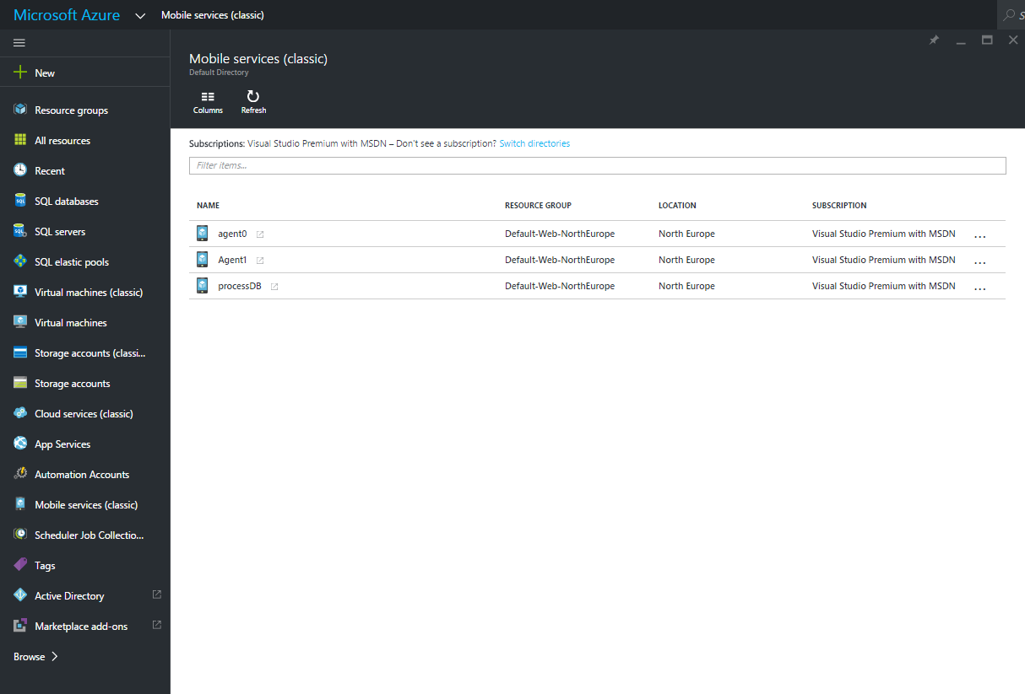
App Service Web Jobs
Notes:
Azure App Service Web Jobs
The App Service has a scheduler called WebJobs. This supports several type of scripts including .NET executables, node.js and PowerShell.
To create an Azure App Service use the “+ New” link then “Web + Mobile” and then Mobile App. Enter an App Name and resource group
You can create Data Connections, environment variables and WebJobs from the Settings menu.
There are only two types of WebJob, either continuous or Triggered.
Continuous means just that, it runs continuously, probably not best suited for SQL Jobs.
Triggered can be scheduled with a cron expression. (Cron is a Unix scheduler) or from a WebHook. If you want run on-demand then select WebHook.
I have created a .NET console application that works but it is supposed to be able to use the connection strings in the Azure App Service as if they are in an app.config file but so far I have failed to get it to do that.
I either have to include the app.config file or use the environment variables.
One of the major advantages of a WebJob is that it has a web page to view the status and output of the WebJob so it can be monitored from the Internet.
Right click on the WebJob to run it, delete it or view the log
At the moment once you created a WebJob you can’t make any changes to it. You must create a new one with the new code or schedule.
.NET Code and PowerShell examples can be found in my e-book
This web site can help you created Cron expressions http://www.cronmaker.com/

Slide 45
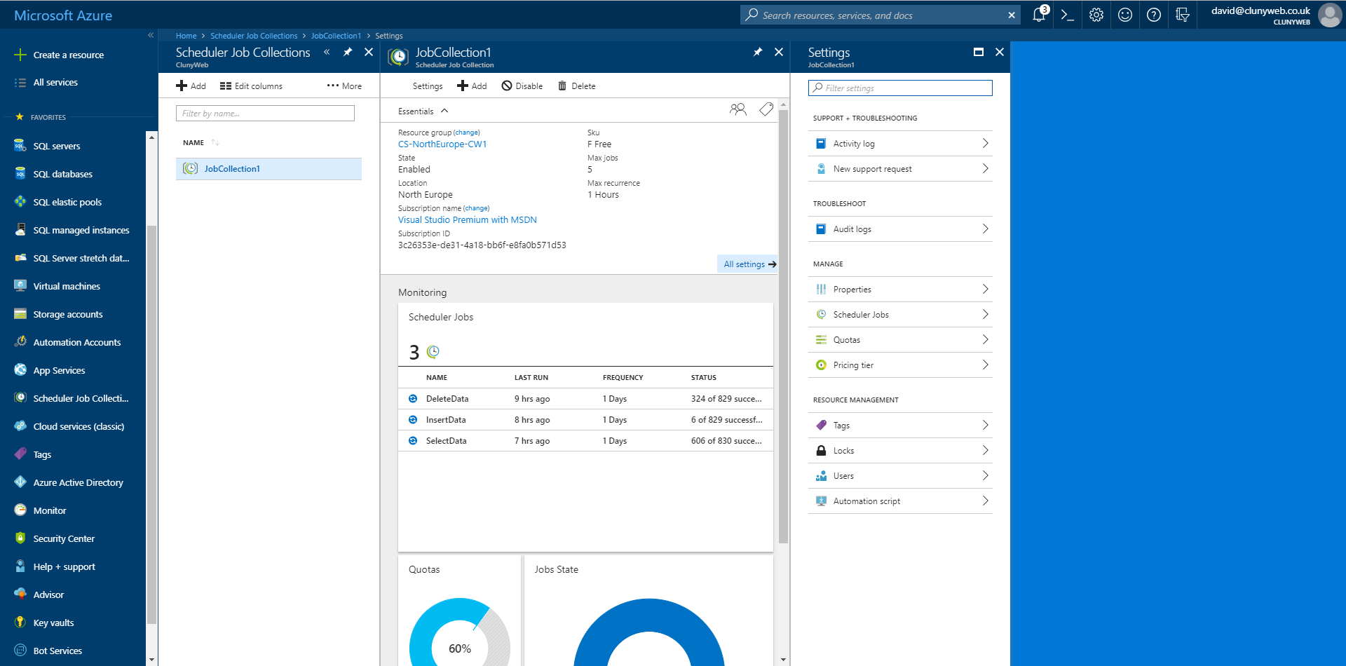
Azure Scheduler Job Collection
Notes:
Azure Scheduler
An alternative to the above is to use a web page to process your SQL data
This web page can then be called using the Azure Scheduler
This is working pretty well but you may hit timeout issues if the web page takes a while to run. In my experience the stored procedure continues to run even if the web page times out
There are options available in the scheduler which you can’t change from the portal. You need to write .NET code to configure these.
The scheduler can also be used to trigger WebJobs. Not tried it myself yet.

Slide 46
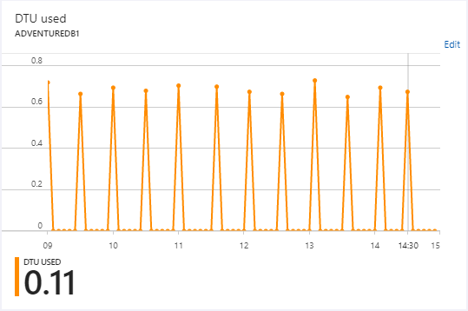
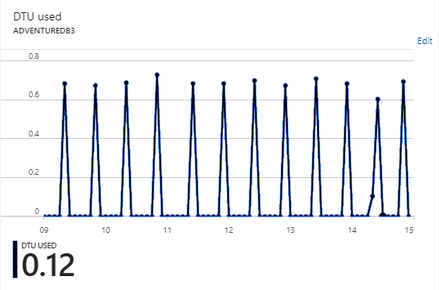
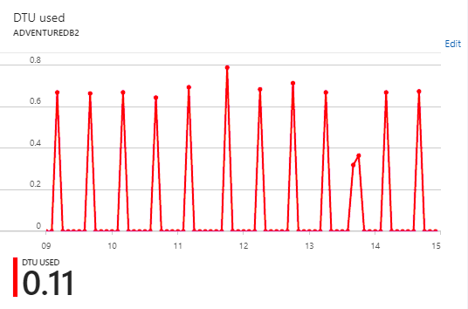
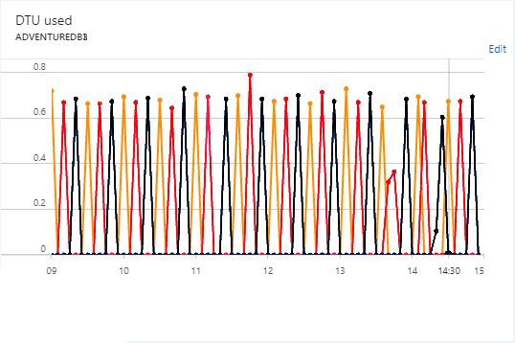
Elastic Pools
Notes:
Elastic Pools
Trying to monitor and manage your SQL databases to ensure that each one is running at the right DTU could be quite a challenge if you have lots of databases.
You can use alerts and automation to automatically move a database up and down the performance tiers but a change to the DTU requires the database to be restarted which can cause downtime
If you have databases with regular peaks in-between low activity, constantly changing the DTU may be impractical
Let’s take a look at an example of how elastic pools can benefit you
Here is a report from three Azure SQL databases.
As you can see each one peaks every 20 minutes but between that peak activity is pretty close to zero.
With Standalone Azure databases we will need to size each database to cope with that maximum peak but we still have to pay for that performance level between those peaks when its not needed
If we merge those performance graphs we can see that (in this case) the combined total DTUs has not increased.
In this case if we could share the Power then all three databases could run in the same number of DTUs rather than each database having to use its own DTU costing us a total of three times as much
By pooling the power available we can use less DTUs overall to achieve the same performance.
This is what an Elastic Pools gives us.
With an Azure Elastic Pool we can place these databases into a shared pool of DTUs. Now we are making much better use of the power available to us and saving money

Slide 47
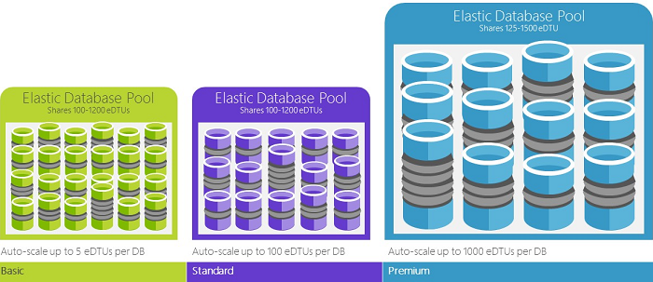
Elastic Pools
Elastic Database Units (eDTU)
Databases can share resources of the pool
Database can AutoScale
Can add and remove eDTUs without downtime
Minimum price £55 / month
Good for Sharded databases
Notes:
Elastic Pools
Trying to monitor and manage your SQL databases to ensure that each one is running at the right DTU could be quite a challenge if you have lots of databases.
You can use alerts and automation to automatically move a database up and down the performance tiers but a change to the DTU requires the database to be restarted which can cause downtime
If you have databases with regular peaks of high activity in-between low activity, constantly changing the DTU may be impractical.
This is where elastic pools can help
An Azure Elastic Pool allows us to place our databases into a shared pool of DTUs.
The shared resources in an elastic pool are measured in elastic Database Transaction Units or eDTUs.
A pool is given a set number of eDTUs, for a set price.
Within the elastic pool, individual databases can auto-scale to gain or reduce resources as required.
Under heavy load, a database can use more eDTUs to meet demand while databases under light loads consume less
Additional eDTUs can be added to or removed from a pool with no database downtime and with no impact on the databases in the pool.
You can add or remove databases from the pool, or limit the amount of eDTUs a database can use under heavy load to reserve eDTUs for other databases.
Its not cheap. The minimum basic level elastic pool is £55 / month.
You require 15-20 databases to make it worth while
Elastic Pools are very good for sharded databases where a large database is split into several smaller databases either because the database has become larger than Azure will support or to the spread the power over several databases thereby increasing the overall power available.
But sharding is a talk all on its own.

Slide 48
Azure Elastic Jobs
Elastic Database jobs for Azure SQL Database allow you to reliably execute T-SQL scripts that span multiple databases while automatically retrying and providing eventual completion guarantees.
Only Supports T-SQL scripts
Can run on multiple databases
Not limited to databases within Elastic Pool
No decent GUI within the Portal
Requires PowerShell to get full features
Notes:
Elastic Database Jobs
In 2016 Microsoft added a scheduler to SQL database called Elastic Database Jobs.
At the time of writing (May 2018) it is still in preview.
Microsoft say:
Elastic Database jobs allow you to reliably execute T-SQL scripts that span multiple databases while automatically retrying and providing eventual completion guarantees.
* What this means is that you can run native t-SQL scripts against an Azure SQL database. You don't need to write complex Powershell or c# code to run your scripts
More importantly your script can be run against multiple databases in one go.
This makes it very handy for Sharded databases within your elastic pool. It will continue to retry on each database until it completes or the timeout value is reached
But Elastic Database jobs are not limited to running on databases within the elastic pool. It can be setup to run against any Azure SQL database
The bad news is that the options within the portal are very limited.
The good news is we can install and run Elastic database jobs using PowerShell from your desktop

Slide 49
Azure Elastic Queries
Linked Servers for Azure SQL Database
Doesn’t require an Elastic Pool
Can only run select statements. Can do updates
Very good for retrieving data from sharded databases
Notes:
Elastic Queries
One of the features missing from Azure SQL database is the ability to create Linked Servers.
However there is something similar called Azure SQL Database Elastic Query
This allows you to run queries against another Azure SQL database or Azure Data Warehouse.
The name is a bit a confusing. You might think that you require a Elastic Pool to be able to run an Elastic query but this is not the case.
You can run Elastic queries from any Azure SQL database to any other Azure SQL database
A major drawback is that it doesn’t support updates, just selects

Slide 50
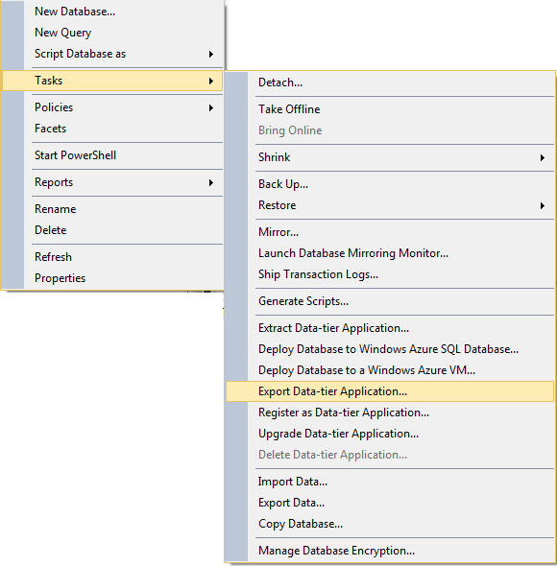
Creating DACPAC and BACPAC
Notes:
Creating DACPAC and BACPAC
In SSMS right click on a database, select tasks
Extract Data-tier Application – DACPAC
Export Data-tier Application – BACPAC
We’ll export a database to Azure for the Data Sync demo

Slide 51
DACPAC and BACPAC
SSMS 2012+
BACPAC Export Data Tier Application – schema + data
DACPAC Extract Data Tier Application - schema
Azure currently only supports BACPAC
Validates the schema before creating the file
Save to local disk
Copy BACPAC to Azure storage for Import from the Management Portal
Or
Export straight to new database on Azure Server
Notes:
DACPAC and BACPAC
You can take your own backups using the Export button at the top of the SQL dashboard
These will create a backup file in your Azure blob storage account
Azure does not support traditional SQL Server backup files
There is a new type of backup file which is more like an installation script than a traditional backup.
The Microsoft term is “Data Tier Application “
BACPAC is a copy of the schema and the data
This is used as a Backup to create a new database
Unlike traditional backups you cannot use BACPACs to restore over the top of an existing database.
DACPAC is a copy of just the database schema.
This can be used for updating schema of an existing database. Ideal for updating production schema from UAT without having to write T-SQL scripts
You can create DACPACs and BACBACs of your local databases from SSMS 2012 and above. BACPACs can then be copied to your Azure Blob Storage and then used to create an Azure SQL database

Slide 52
Stretch Tables
Take advantage of “cheap” Azure storage
Split a table in two Place “old” data in a database in Azure Leave current data “on premises”
Query knows if data is in current table or archive table and returns merged results seamlessly
SQL will move data to Azure when it becomes “old”
Lots of limitations
Not as cheap as it looks (minimum of €1500/month)
Notes:
Stretch Database
This is new to SQL 2016
Stretch Database allows you to stretch (or split) an “On-Premises” table onto an Azure SQL Database
so that your most frequently accessed data is stored in your data centre, while your less accessed, maybe historical, data is held in the cloud
The idea being that you can keep the most frequently accessed data in a smaller table on your local server close to the users and take advantage of cheap cloud storage to hold your less frequently accessed data.
When you enable a table to “stretch” the older data moves over to the Azure SQL database behind the scenes.
When you need to run a query that accesses active and historical information in a “stretched” table the database engine seamlessly queries both the On-Premises database as well as Azure SQL database and returns the results to you as if they had come from a single source.
But its not cheap

Slide 53
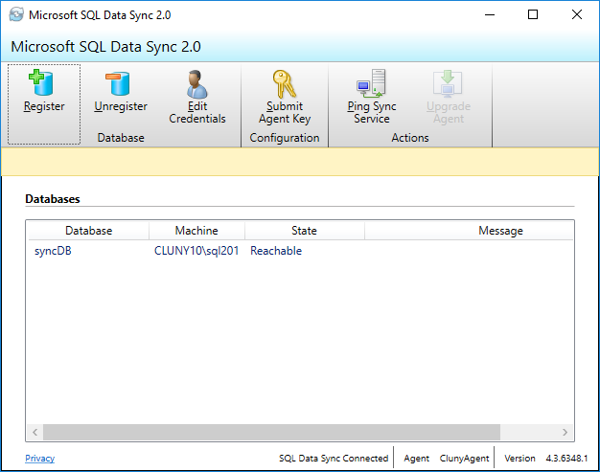
Azure Data Sync 2.0
Synchronise data between two databases
Either Azure to Azure
Or Azure to “On Premises”
Notes:
Azure Data Sync allows you to synchronize changes between an Azure SQL Database and a local database or other Azure database in a similar fashion but much simpler to traditional replication.
It can synchronise data between an Azure database and up to 50 other databases either other Azure databases or On premises databases.
You install a small service on your SQL server that acts as the link between your local database and the Azure database
Its quite tricky to setup but it does seem to work quite well

Slide 54
Azure SQL Database Managed Instance
Still in preview
Very Limited Access at the moment ( I can’t get onto it)
Offers Paas SQL Server that looks and acts like a traditional SQL Server
Ability to lift “On Premises” SQL Server to Azure
Only Supports vCore model
Offers Paas capabilities like Automatic patching backups and HA
Notes:
Azure SQL Database Managed Instance (preview) is a new capability of Azure SQL Database, providing near 100% compatibility with SQL Server on-premises (Enterprise Edition), providing a native virtual network (VNet) implementation that addresses common security concerns, and a business model favorable for on-premises SQL Server customers.
Managed Instance allows existing SQL Server customers to lift and shift their on-premises applications to the cloud with minimal application and database changes.
At the same time, Managed Instance preserves all PaaS capabilities (automatic patching and version updates, backup, high-availability), that drastically reduces management overhead and TCO.

Slide 55
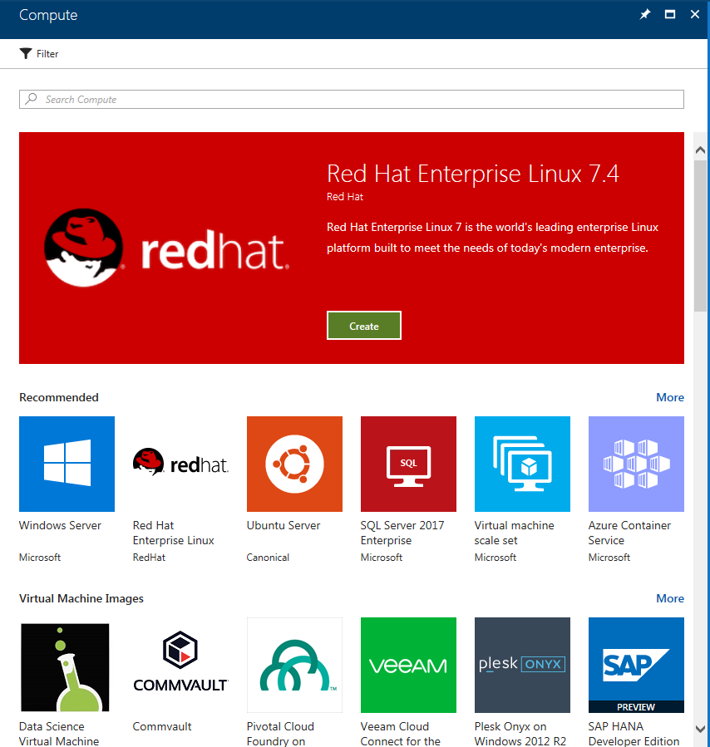
Azure Virtual Machine
Notes:
Virtual Machines
If you would prefer more control over your SQL instance, or you would prefer to have a SQL server that looks like the one in your office then you can create a virtual server.
A VM is an example of Infrastructure as a service
This is quite a simple process.
Again click New and select a server type from the list.
If you take a look at the gallery you’ll see there is a huge choice of server to select from and not just Microsoft operating systems and applications such as Oracle database on both Windows and Linux servers.
You can use RDP (Remote desktop) to access the Windows server and then configure and manage it just like any Windows Server.
You can create automation accounts to shutdown a virtual server when you don’t need it, such as overnight and then restart it in the morning which can save you money.
You can’t do that to Azure SQL database. Its always turned on and costing you.

Slide 56
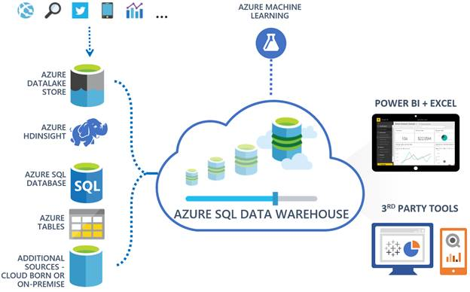
Azure Data Warehouse
Notes:
Azure Data Warehouse
Azure SQL Data Warehouse is a fully-managed (PaaS) and highly scalable cloud based distributed relational database management system for data warehousing workloads.
Azure SQL Data Warehouse is built on Massively Parallel Processing (MPP) architecture, capable of processing massive volumes of data (both relational and non-relational), processing data in parallell across multiple nodes and offering other enterprise-class features to handle enterprise data warehouse workloads.
http://www.databasejournal.com/features/mssql/getting-started-with-azure-sql-data-warehouse-part-1.html

Slide 57
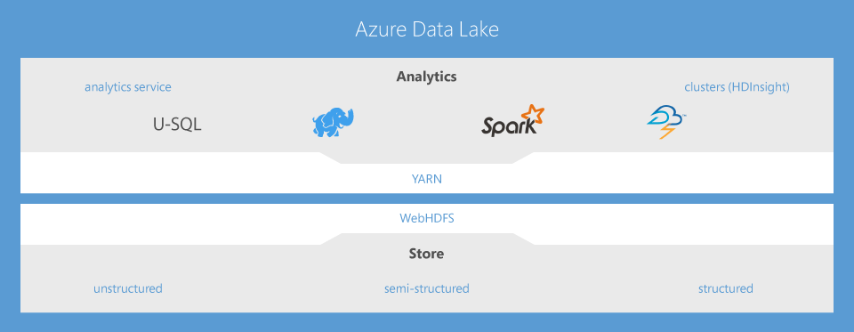
Azure Data Lake
Notes:
Azure Data Lake
Azure Data Lake stores data of any size and shape for all types of processing and analytics across platforms and languages.
It removes the complexities of ingesting and storing all your data while making it faster to get up and running with batch, streaming and interactive analytics.
Azure Data Lake works with existing IT investments for identity, management and security for simplified data management and governance.
It also integrates seamlessly with operational stores and data warehouses so that you can extend current data applications.
Azure Data Lake solves many of the productivity and scalability challenges that prevent you from maximising the value of your data assets with a service that’s ready to meet your current and future business needs.

Slide 58
Do You need a DBA with SQL Azure
Answers on a post card….
Notes:
Do you require a DBA with Azure?
With Azure creating a database is as simple as clicking a button on a screen. Many of the DBA task like backups, high availability, disaster recovery and failover have been taken care of
You might be thinking is there anything left for a DBA to do?
Yes there is.
The tedious tasks have been taken away such as building SQL , checking backups, checking mirroring / always on is working
But bad design requiring more DTUs will now have a visible cost, whereas before the cost of adding extra CPU or memory to your local virtual server probably just got lost.
So DBAs will now be able to get on with the interesting stuff, being involved in the database design, tuning queries to keep costs down.
And will be able to demonstrate their value by the number of DTUs saved and thus the amount of money saved.

Slide 59
Grammar
Prem
Premise
Premises
– short for premises
– a proposition or assumption
– a building or property
Notes:
Grammar
I’m a bit of a stickler on grammar and I cringe every time hear someone who is talking about cloud computing use the expression “on premise” rather than “on premises”.
A premise is a proposition or assumption and has nothing to do with buildings.

Slide 60
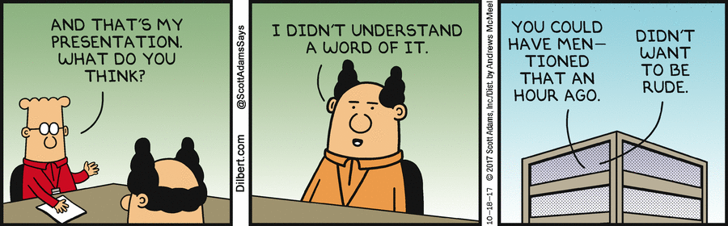
Any Questions
Conclusion
Hopefully you now have a better understanding of what
Microsoft Azure can offer you
Free e-book from gethynellis.com
david@clunyweb.co.uk
@postledm
https://www.linkedin.com/in/davidpostlethwaite
www.youtube.com/c/DavidPostlethwaiteSQL
Notes:
Any Questions
Hopefully you now have a better understanding of SQL Azure
And will be able to use it safely in your environment

Slide 61
Thank You

